Slide 1
Reference Material
v4 Roger Deck
v5 Modified Deck
Notes:
In addition to learning about the topics in the agenda, you will be able to try your hand at writing and testing some Sentinel policies in a lab environment.
This presentation and the exercises are based on the Writing and Testing Sentinel Policies for Terraform guide: https://storage.googleapis.com/instruqt-hashicorp-tracks/sentinel-shared/WritingAndTestingSentinelPoliciesForTerraform-v3.0.pdf

Slide 2
Sentinel for Terraform Workshop (v5)
<Instructor>
Global Technology Specialist
HashiCorp
Notes:
These slides are intended to accompany the Sentinel for Terraform v4 workshop
You can follow along at https://storage.googleapis.com/instruqt-hashicorp-tracks/sentinel-shared/Sentinel-for-Terraform-v4.pptx
They should be used with these tracks:
Sentinel CLI Basics
Sentinel for Terraform v4

Slide 3
Workshop Agenda
Introduction To Sentinel Concepts
Lab Challenge 1: Using the Sentinel CLI
Lab Challenge 2: Applying and Testing a Policy with the CL
The Sentinel Language
Key Concepts
Sentinel Imports and Modules
Advanced Concepts
Writing Sentinel Policies and Testing them with the Sentinel CLI
Lab Exercises 1-2: Write and Test Your First Policies
Using Sentinel in Terraform Cloud
Lab Exercises 3-5: Write and Test More Policies
Advanced Techniques
Extra Credit Challenge
Notes:
In addition to learning about the topics in the agenda, you will be able to try your hand at writing and testing some Sentinel policies in a lab environment.
This presentation and the exercises are based on the Writing and Testing Sentinel Policies for Terraform guide: https://storage.googleapis.com/instruqt-hashicorp-tracks/sentinel-shared/WritingAndTestingSentinelPoliciesForTerraform-v3.0.pdf

Slide 4
Chapter 1 - Introduction To Sentinel Concepts
Notes:
Let's talk about Sentinel and how it fits into Terraform Cloud and Terraform Enterprise.
We'll also discuss how customers are using Sentinel in TFC and TFE.

Slide 5
What is Sentinel?
Sentinel is a Policy As Code framework to enable fine-grained, logic-based policy
“Sentinel is to a Policy Framework as
Terraform is to Infrastructure as Code”
It includes its own language and is embedded in HashiCorp’s Enterprise products.
It supports fine-grained policies that use conditional logic.
Is this image in the supported images list?
It includes a CLI that allows you to test policies.
Notes:
Sentinel is a framework for implementing governance policies as code
It has its own language
It has a CLI for testing and running policies

Slide 6
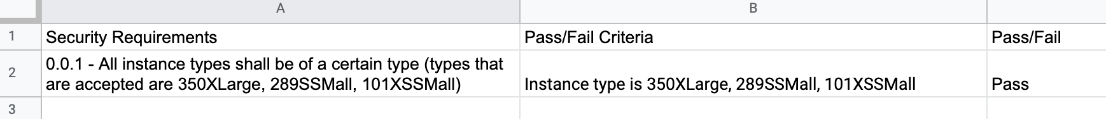
What is Sentinel?
Sentinel is enabled as part of your provisioning workflow, ensuring that policies are checked each time Terraform runs
Policy as Code takes your excel spreadsheets, legal, regulatory requirement documents and individual security best practice knowledge and turns it into Code.
(allowed_types = [”350xlarge”,”289ssmall”,”101xssmall”])

Slide 7
Benefits of Policy as Code
All the same benefits of Infrastructure as Code!
Version History, Change Control, Collaboration
Easily share-able and consumable across multiple organizations and teams in Terraform Cloud
Can be tested and iterated on in an automated fashion with real test data!*
Notes:
Imagine a pipeline with mock data and automated testing

Slide 8
How Customers are Using Sentinel in Terraform
HashiCorp customers are using Sentinel to enforce security standards:
Require all S3 buckets use the private ACL and be encrypted by KMS.
Restrict which roles the AWS provider can assume.
Prohibit specific resources, data sources, providers, or provisioners.
# List of allowed providers
allowed_list = ["aws", "local", "null", "random", "terraform", "tfe"]
Notes:
Let's talk about some use cases for Sentinel in TFC and TFE.

Slide 9
How Customers are Using Sentinel in Terraform
HashiCorp customers are using Sentinel to avoid excessive costs:
Limit the sizes of VMs and Kubernetes clusters in public clouds.
Limit the monthly spend of each Terraform workspace.
Other:
Enforce mandatory tags on resources provisioned by Terraform.
Mandate that all modules come from a Private Module Registry.
# List of allowed resources
allowed_list = ["aws_instance", "azurerm_virtualmachine", "google_compute_instance"]
Notes:
Let's talk about some use cases for Sentinel in TFC and TFE.

Slide 10
What Sentinel Does Not Do in Terraform
Continually check infrastructure to validate compliance
Remove existing resources that violate policies
Ensure that resource attributes are valid
For instance, Sentinel can validate that a KMS key is specified for an S3 bucket, but not that it is a valid key.
Can’t check if “SuperLargeBigInstance” is a valid type
Analyze or limit runtime actions of deployed applications
Notes:
Sentinel does not everything under the sun.

Slide 11
Where is Sentinel Used in Terraform?
Sentinel Policies are checked between the standard plan and apply steps of Terraform runs.
Policies have different enforcement levels.
Sentinel policies can evaluate the attributes of existing and new resources based on information from the current run:
the plan, the configuration, the current state, and other run data including cost estimates
This ensures that resources comply with all policies before they are provisioned.
Notes:
Let's talk about where Sentinel is used in TFC and TFE.
It is run between the plan and the apply of a run.
If cost estimates are enabled for a workspace, the Sentinel policies are checked after the cost estimates are collected.
"Arguments" are the inputs to Terraform resources and data sources.
Each resource and data source also exports certain attributes that are computed during the apply. These are called "exported attributes".
But since the arguments or a resource are also exported, it is common to use "attributes" to refer to the union of a resource's arguments and exported attributes.

Slide 12

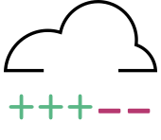
How Terraform Works Without Sentinel
VCS
Terraform
plan & apply
Infrastructure
Notes:
Here is how Terraform works without Sentinel.

Slide 13

How Terraform Works With Sentinel
VCS
Terraform
Cloud
Workspace
plan
Sentinel
Policy
Checks
apply
Infrastructure
If cost estimates are enabled, they run right after the plan.
Notes:
Here is how Terraform works with Sentinel.
Note that if cost estimates are enabled for the workspace, they will run right after the plan.

Slide 14
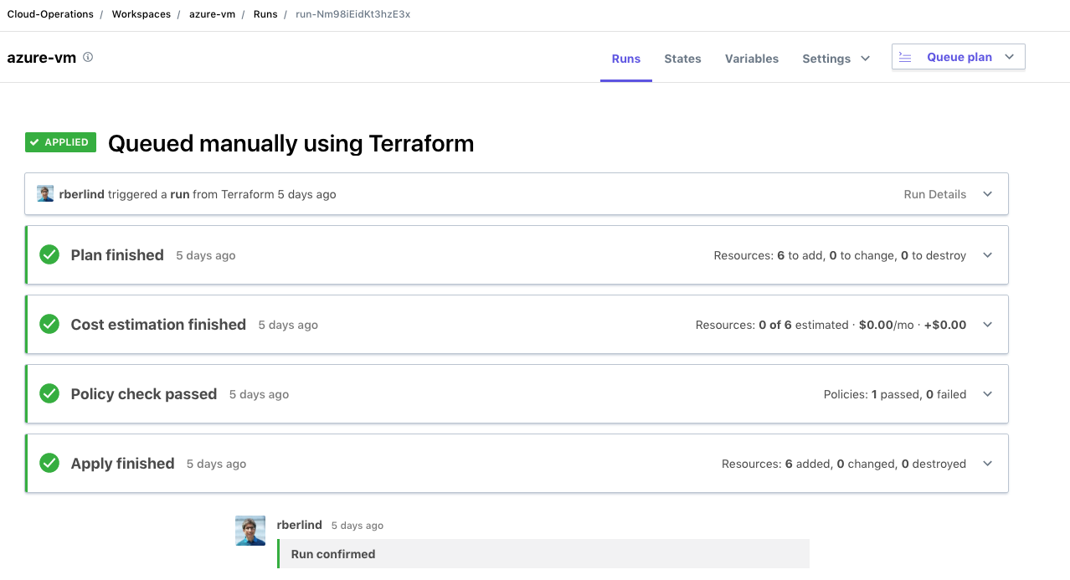
All Policy Checks Passed
Notes:
A screenshot from TFC showing that all policy checks passed for a run.
Note that output from policies can be viewed in two formats: text and json.

Slide 15
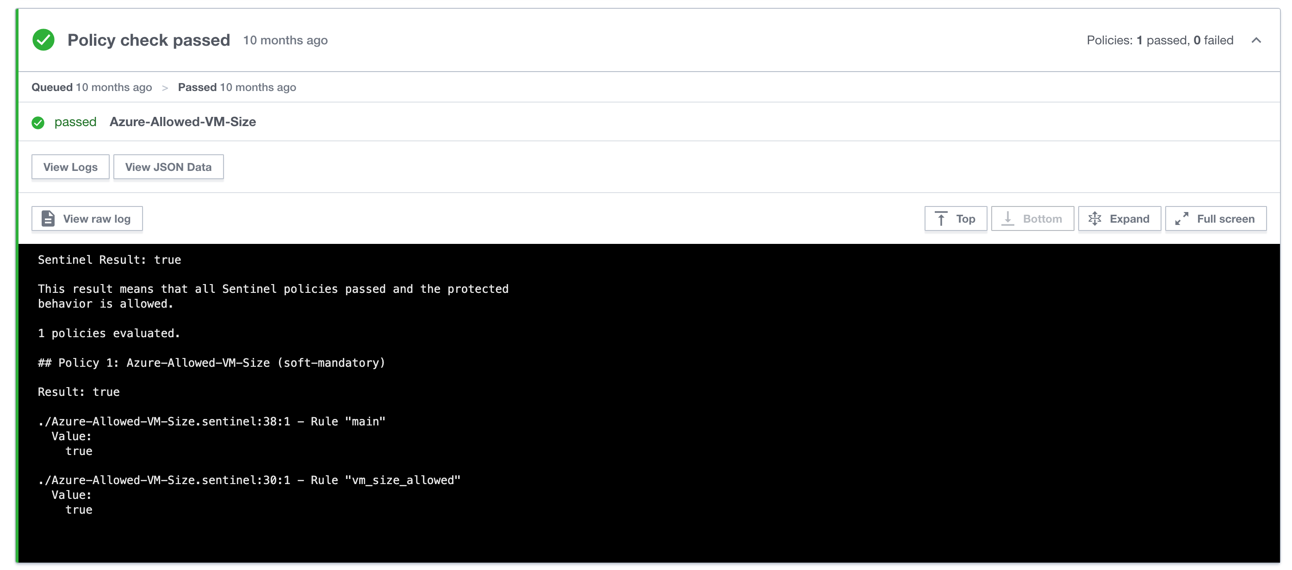
All Policy Checks Passed
Notes:
A screenshot from TFC showing that all policy checks passed for a run.
Note that output from policies can be viewed in two formats: text and json.

Slide 16
Sentinel Policy Enforcement Levels
Advisory
Only logs violations
Soft Mandatory
Can be overridden by authorized users
Hard Mandatory
Cannot be overridden by anyone
Customers often create new Sentinel policies as Advisory, then transition to Soft Mandatory, and eventually to Hard Mandatory.
This gives Terraform coders time to adapt and modify their code.
Notes:
There are 3 enforcement levels for Sentinel policies.
Users with sufficient permissions can override soft mandatory policies.

Slide 17
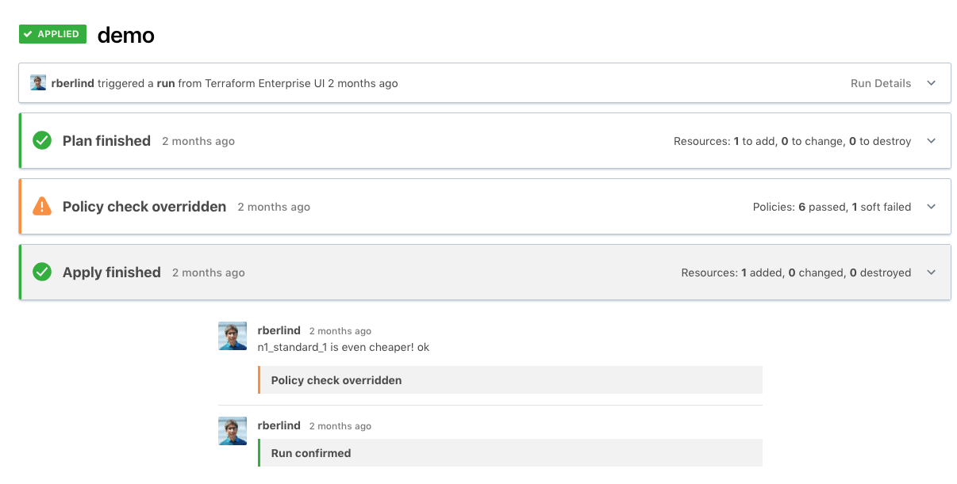
A Soft Mandatory Policy Check Was Overridden
Notes:
A screenshot from TFC showing a soft mandatory policy check that failed but was then overridden.

Slide 18
Sentinel Policy Sets and Policies
Policy Sets are groups of Sentinel Polices (and optionally Sentinel Modules)
They can be enforced on all workspaces or only on selected workspaces within one or more organizations.
They are usually created in VCS repositories and then registered with organizations using the Terraform Cloud UI or API.
Additionally, Parameters can be added to policy sets allowing the secure introduction of credentials needed by API endpoints invoked with the Sentinel HTTP import.
Notes:
Sentinel policies are added to TFC/TFE organizations using Policy Sets.
They are usually created in VCS repositories, but it is also possible to use non-VCS-backed policy sets and upload files to them with the TFC/E Policy Set Versions API endpoint.
Non-VCS-backed policy sets can load a tar file including a sentinel.hcl policy set definition file, policies, and Sentinel modules.
See https://github.com/hashicorp/terraform-guides/blob/master/operations/sentinel-policies-scripts/create-policy-set-version.sh
The sentinel.hcl file can also refer to remote Sentinel modules and policies in VCS repositories.
Parameters can be added to both VCS-backed and non-VCS-backed policy sets, but not for the latter if you use the TFE provider to create the policy set.

Slide 19
Chapter Summary
Sentinel is Policy as Code framework
Terraform Cloud automatically runs Sentinel checks between plan and apply
Sentinel has different enforcement levels, Advisory, Soft and Hard Mandatory

Slide 20
Chapter 1 - Complete
Notes:
Let's spend some time discussing the Sentinel language.

Slide 21
Reference
Main Sentinel Docs
Terraform Cloud Sentinel Docs
GitHub Repository with Sample Sentinel Policies for AWS, Azure, GCP, and VMware as well as useful common functions in modules
Guide to Writing and Testing Sentinel Policies in Terraform
Notes:
This slide gives some useful links that will help you learn how to use Sentinel in TFC and TFE and how to write your own Sentinel policies.
The instructor should show these links to the students.

Slide 22
Workshop Challenge 1: Using the Sentinel CLI
Notes:
Now we will do the first workshop challenge on the Instruqt platform
First Challenge Part 2

Slide 23
Challenge 1: Using the Sentinel CLI
The hands-on lab exercises of this workshop are done in an interactive learning platform Instruqt
For this workshop, please use links provided by your instructor for these tracks:
Sentinel CLI Basics
Sentinel for Terraform v4
In the first challenge of the first track, you'll learn how to run Sentinel CLI commands.
Notes:
The workshop exercises leverage the Instruqt platform and make solving the exercises much easier.
We recommend you not start the second track until the second session when the workshop is delivered in two sessions.

Slide 24
Instruqt Basics
The Instruqt platform organizes training content into Tracks consisting of multiple Challenges that must be solved in a specific order.
Each track launches one or more VMs and/or Docker containers and exposes terminals, file editors, and user interfaces on Tabs.
Information about each challenge is displayed on Note screens while it is loading. A Start Button will be shown when the challenge is ready.
Detailed instructions are listed in an Assignment to the right of the tabs.
You can click the Check Button to verify if you have completed the assignment. If you have, you will advance to the next challenge. Otherwise, you will be given a hint about what to do next.
We recommend you review Instruqt's own tutorial track for more details
Notes:
Here are some basics about Instruqt.
You might also want to spend 5 minutes reviewing Instruqt's own tutorial track.

Slide 25
Workshop Challenge 2: Applying and Testing Policies
Notes:
Now we will do the first two workshop challenges on the Instruqt platform

Slide 26
Challenge 2: Applying and Testing Policies
In the second challenge, you'll learn how to apply and test a simple Sentinel policy with the Sentinel CLI.
Please continue in your running instance of the Sentinel CLI Basics track by clicking the green Check button.
Notes:
The workshop exercises leverage the Instruqt platform and make solving the exercises much easier.
We are doing the second challenge in Sentinel CLI Basics

Slide 27
Terraform Cloud and Terraform Enterprise
Terraform Cloud (TFC) includes the following advanced functionality that makes it easier for teams and organizations to use Terraform:
A User Interface
Workspace Management
Team Management
State Management
Secure Variable Management
Remote Runs and State
VCS Integrations
HTTP/JSON API
Private Module Registry
Configuration Editor
Sentinel (policy as code)
SSO via SAML Integration
Audit Logging
Customers can install Terraform Enterprise (TFE) servers to self-host TFC in their own cloud virtual private networks or in their data centers.
Notes:
Let's level set about Terraform Cloud and Terraform Enterprise
Note that Terraform Cloud (TFC) refers both to the actual application used and the implementation hosted by HashiCorp at app.terraform.io.
Since TFE uses the TFC application, we will mostly just talk about TFC.
But anything we say about TFC is true of TFE too except when we discuss very new features that have been released to TFC.
But those new features generally end up in TFE within 4-6 weeks.

Slide 28
The v2 Versions of the Terraform Sentinel Imports
The v2 versions of three Terraform Sentinel imports (tfplan, tfstate, and tfconfig) are aligned more closely with Terraform's native data structures in versions 0.12 and higher.
This makes the v2 imports easier to use than the v1 imports.
Additionally, since resource instances are stored in a single flat map that spans across all Terraform modules and resource types, it is much easier to find all resources instances of a specific type or a sub-collection of them.
However, the v2 imports can only be used with Terraform 0.12 and higher.
Notes:
Sentinel has some builtin functions that you can use in any policy.

Slide 29
Chapter 2A - Sentinel Language Key Concepts
Notes:
Let's spend some time discussing the Sentinel language.

Slide 30
What Does Sentinel DO in Terraform?
Sentinel has the ability to “check” any resources inside Terraform
Using the concept of ‘imports’ Sentinel can get data from Terraform;
Plan
Config
Run
Much much more!
Notes:
Examples can be found here https://www.terraform.io/cloud-docs/sentinel/examples

Slide 31
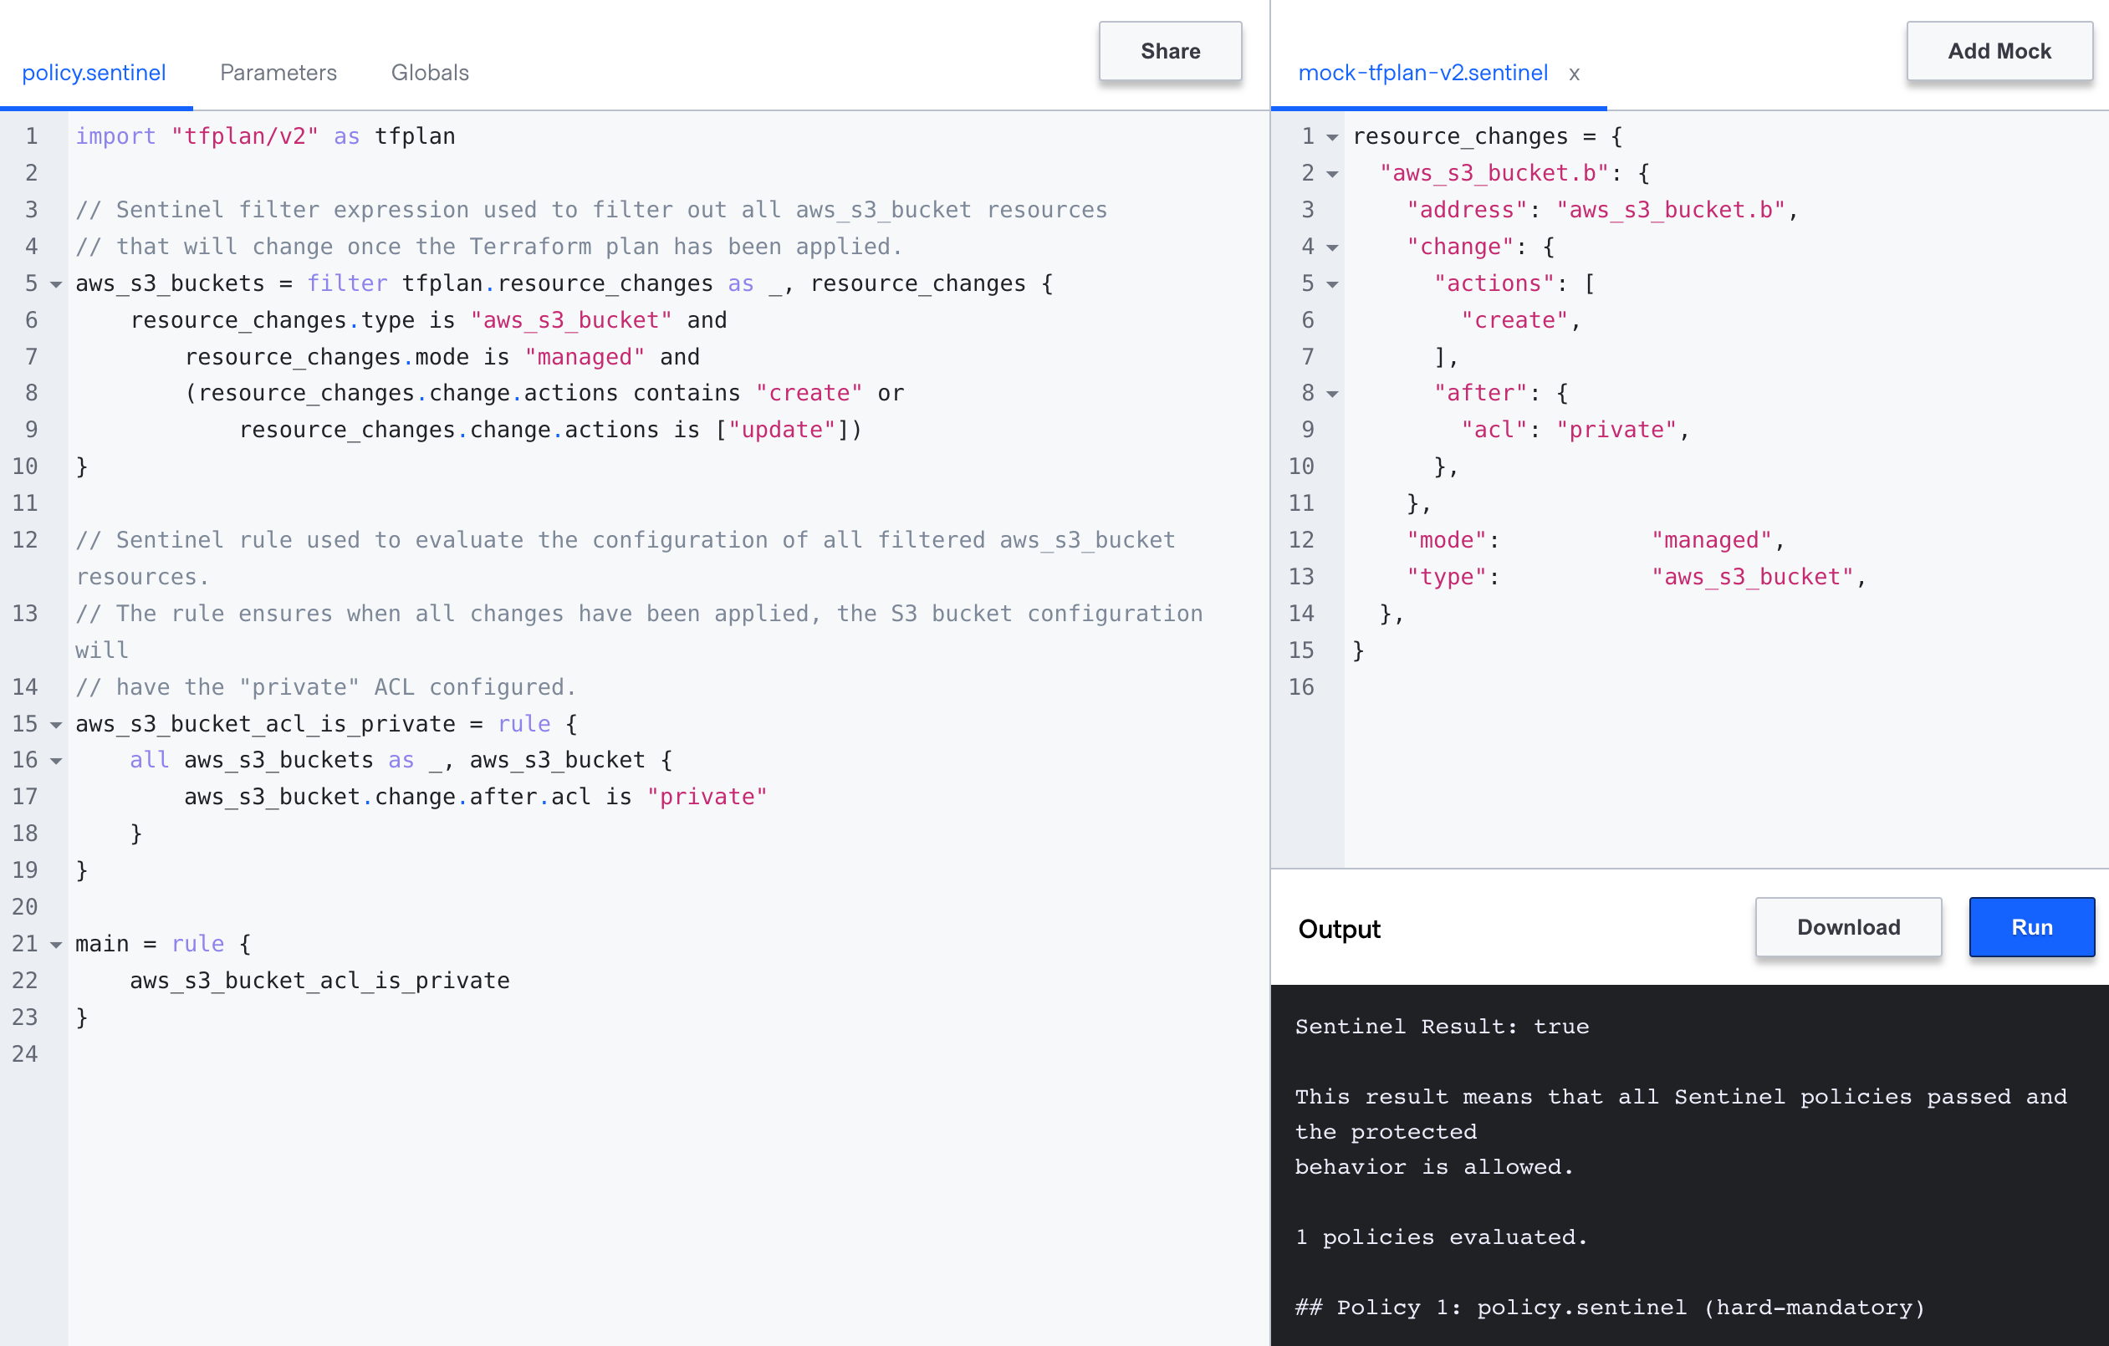
What Does a Sentinel Check Look Like?
Notes:
Examples can be found here https://www.terraform.io/cloud-docs/sentinel/examples

Slide 32
Sentinel Mocks in Terraform
Sentinel Mocks simulate the data from Terraform plans
They can be generated from Terraform Cloud
Mocks can be edited and modified to simulate other data
They enable testing of Terraform Sentinel policies with the Sentinel CLI.
Using the Sentinel CLI with mocks speeds up development of new policies since additional plans do not need to be run.
Notes:
You can generate Sentinel mocks from Terraform plans in TFC/TFE.
You can then use these mocks when testing policies with the Sentinel CLI

Slide 33
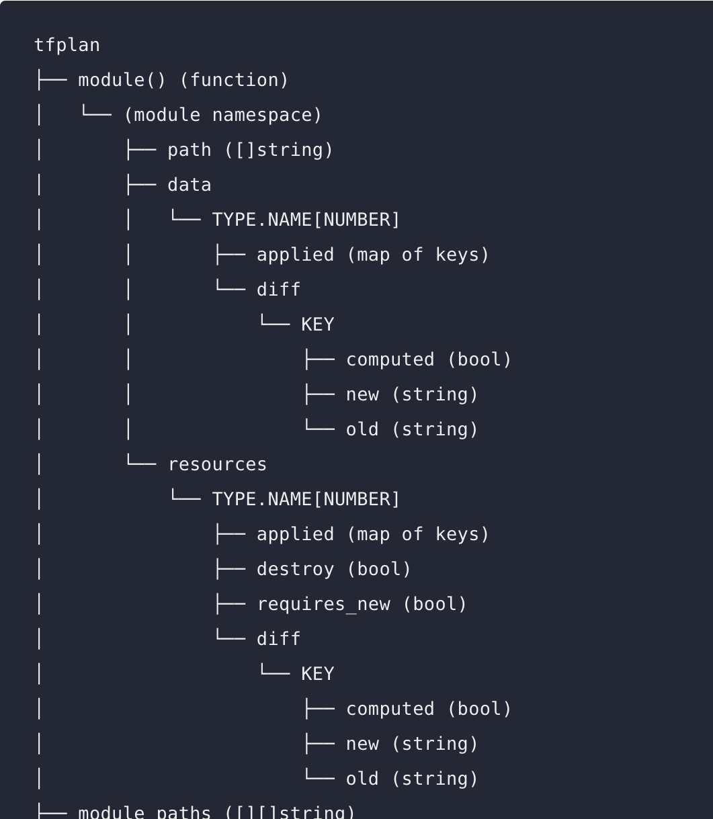
How Terraform Works With Sentinel
Terraform
Cloud
Workspace
plan
apply
Infrastructure
Sentinel
Yes
aws_s3_bucket_acl_is_private?
Notes:
Here is how Terraform works with Sentinel.
Note that if cost estimates are enabled for the workspace, they will run right after the plan.

Slide 34
Sentinel Policy Introduction – Concepts (0)
Imports
Modules and Functions
Declare criteria to evaluate against
Approved images, “Right” ports to use, “allowed” regions
Find all the resources in Terraform to evaluate against
Find all images, find all port configurations, find all regions
Evaluate
Test
Print Errors
Notes:
First we’re going to import some common functions, we’ll introduce functions later in this course, but at a high level they are self contained portions of code that do a task

Slide 35
Sentinel Policy Introduction – Concepts (1)
import "tfconfig-functions" as config
allowed_list = ["aws_instance", "azurerm_virtualmachine", "google_compute_instance”]
allResources = config.find_all_resources()
violatingResources = config.filter_attribute_not_in_list(allResources, "type", allowed_list, true)
main = rule { length(violatingResources["messages"]) is 0 }
Notes:
First we’re going to import some common functions, we’ll introduce functions later in this course, but at a high level they are self contained portions of code that do a task

Slide 36
Sentinel Policy Introduction – Concepts (2)
import "tfconfig-functions" as config
allowed_list = ["aws_instance", "azurerm_virtualmachine", "google_compute_instance”]
allResources = config.find_all_resources()
violatingResources = config.filter_attribute_not_in_list(allResources, "type", allowed_list, true)
main = rule { length(violatingResources["messages"]) is 0 }
Notes:
First we’re going to import some common functions, we’ll introduce functions later in this course, but at a high level they are self contained portions of code that do a task

Slide 37
Sentinel Policy Introduction – Concepts (3)
import "tfconfig-functions" as config
allowed_list = ["aws_instance", "azurerm_virtualmachine", "google_compute_instance”]
allResources = config.find_all_resources()
violatingResources = config.filter_attribute_not_in_list(allResources, "type", allowed_list, true)
main = rule { length(violatingResources["messages"]) is 0 }
Notes:
First we’re going to import some common functions, we’ll introduce functions later in this course, but at a high level they are self contained portions of code that do a task

Slide 38
Sentinel Policy Introduction – Concepts (4)
import "tfconfig-functions" as config
allowed_list = ["aws_instance", "azurerm_virtualmachine", "google_compute_instance”]
allResources = config.find_all_resources()
violatingResources = config.filter_attribute_not_in_list(allResources, "type", allowed_list, true)
main = rule { length(violatingResources["messages"]) is 0 }
Notes:
First we’re going to import some common functions, we’ll introduce functions later in this course, but at a high level they are self contained portions of code that do a task

Slide 39
Sentinel Policy Introduction – Concepts (5)
import "tfconfig-functions" as config
allowed_list = ["aws_instance", "azurerm_virtualmachine", "google_compute_instance”]
allResources = config.find_all_resources()
violatingResources = config.filter_attribute_not_in_list(allResources, "type", allowed_list, true)
main = rule { length(violatingResources["messages"]) is 0 }
Notes:
First we’re going to import some common functions, we’ll introduce functions later in this course, but at a high level they are self contained portions of code that do a task

Slide 40
Sentinel Policies Deep Dive
Functions:
Execute various statements and return a value.
### find_resources ###
# Find all resources of a specific type using the tfplan/v2 import.
# Include resources that are not being permanently deleted.
# Technically, this returns a map of resource changes.
find_resources = func(type) {
resources = filter tfplan.resource_changes as address, rc {
rc.type is type and
rc.mode is "managed" and
(rc.change.actions contains "create" or rc.change.actions contains "update" or
rc.change.actions contains "read" or (rc.change.actions contains "no-op" and
rc.change.after is not null))
}
return resources
}
Notes:
Here is a function to find all resources of a specific type

Slide 41
Sentinel Policies Deep Dive
OR
Functions
import "tfconfig-functions" as config
Notes:
Left blank for deliberate shock value, here is the import for the function

Slide 42
Sentinel Functions
A Sentinel Function is declared with the func keyword.
find_resources = func(resource_type) {
# Do something and use the parameter
return true
}
Each function has a name such as find_resources.
Each function can have zero or more parameters.
The function above has the single parameter, resource_type
Every function must return a value such as true.
A call to this function could look like:
s3_buckets = find_resources("aws_s3_bucket")
Notes:
Functions are declared with the func keyword.
They all have a name.
They can also have parameters.
They must return a value.
See https://docs.hashicorp.com/sentinel/language/functions for more details.
We'll see calls to functions in policy examples.

Slide 43
Builtin Functions
Sentinel includes some useful Builtin Functions:
append Appends a value to the end of a list
delete Deletes an element from a map
error Immediately exit with an error message
keys Returns the keys of a map
length Returns the length of a collection or string
print Prints what you tell it to. Always returns true.
range Returns a list of numbers in a range.
values Returns the values of a map.
There are also Type Conversion functions, bool, float, int, and string, which convert other types to their type.
Notes:
Sentinel has some builtin functions that you can use in any policy.

Slide 44
Sentinel Keywords
all
any
as
break
case
continue
else
filter
for
func
if
is
import
map
param
return
rule
when
Notes:
Sentinel has some keywords that should not be used as names of variables, functions, or rules.

Slide 45
Chapter Summary
A basic rule of thumb is that Sentinel policies contain;
Imports/Modules/Functions
Evaluation Criteria (Negative or Positive)
A ’Search’ for any resources to test
ONE main rule
One or many rules
Sentinel has built in functions
There’s also common functions you can consume!

Slide 46
Chapter 2A - Completed
Notes:
Let's spend some time discussing the Sentinel language.

Slide 47
Chapter 2B - Sentinel Imports and Modules
Notes:
Let's spend some time discussing the Sentinel language.

Slide 48
Sentinel Policy - Imports
A policy can include imports which enable a policy to access reusable libraries, external data and functions
Imports enable Sentinel to access External Data
Sentinel ships with a set of standard imports
For example, the import:json capability allows you to parse and access a JSON document
The true power in Sentinel is using imports/plugins to make policy decisions on any source of data!
Import “http” enables the use of HTTP-accessible data from outside the runtime in Sentinel policy rules.
Simply put I can query any URL to use data in Sentinel!

Slide 49
Standard Sentinel Imports
Standard Imports:
base64
decimal
http
json
runtime
sockaddr
strings
time
types
units
version
Notes:
See https://docs.hashicorp.com/sentinel/imports
The http import currently only supports the HTTP GET operation against API endpoints that return JSON documents.
It is possible to send data to an API endpoint with the http import using headers or URL parameters.
See https://docs.hashicorp.com/sentinel/imports/http

Slide 50
Common Operations of the Standard Imports
Check if a string has a prefix: strings.has_prefix(s, prefix)
Check if a string has a suffix: strings.has_suffix(s, suffix)
Check the type of a Sentinel object: types.type_of(obj)
Make external calls to API endpoints:
response = http.get("https://example.hashicorp.com")
Convert a JSON object to a Sentinel structure:
json.unmarshal(response.body)
Notes:
See https://docs.hashicorp.com/sentinel/imports
The http import currently only supports the HTTP GET operation against API endpoints that return JSON documents.
It is possible to send data to an API endpoint with the http import using headers or URL parameters.
See https://docs.hashicorp.com/sentinel/imports/http

Slide 51
Sentinel Imports in Terraform
A policy can include imports which enable a policy to access reusable libraries, external data and functions
Imports are Sentinel’s way of accessing data
Remember that Sentinel is embedded across HashiCorp’s Enterprise tools
Cool hint: if you’re using more than one HashiCorp product you could get Sentinel data from them!
Terraform Cloud provides four imports to define policy rules for the plan, configuration, state, and run associated with a policy check
Notes:
Deliberately repetitive, now in the context of Terraform – same as previous slides but specific to terraform

Slide 52
Sentinel Imports in Terraform
tfplan/v2
gives data generated from Terraform plans
tfconfig/v2
gives data about the Terraform configuration
tfstate/v2
gives data about the current state of a workspace
Tfrun
gives metadata for Terraform runs and their workspaces as well as cost estimate data
Notes:
This is a good point to discuss the Terraform-specific Sentinel imports.
Terraform Cloud/Enterprise adds 4 Sentinel imports beyond the standard ones.
This version of the workshop uses the v2 versions of the tfplan, tfconfig, and tfstate imports.
The v2 versions are more closely aligned to Terraform's internal data structures for versions 0.12 and higher.
There is only 1 version of the tfrun import.

Slide 53
Types of Terraform Sentinel Policies
There are essentially four types of Terraform Sentinel policies corresponding to the 4 Terraform Sentinel imports:
Policies can use the tfplan/v2 import to restrict specific attributes of specific resources and data sources in the current Terraform plan.
Policies can use the tfconfig/v2 import to restrict the configuration of Terraform modules, variables, resources, data sources, providers, provisioners, and outputs.
Policies can use the tfstate/v2 import to check whether previously provisioned resources or data sources have attributes with values that are no longer allowed.
Policies can use the tfrun import to check workspace and run metadata and whether cost estimates for planned resources are within limits.
Some policies might use more than one of these imports.
Notes:
There are essentially four types of Sentinel policies, corresponding to the 4 Terraform Sentinel imports (which go beyond the 11 standard imports provided by Sentinel itself).
In this version of the workshop, we are using the v2 tfplan, tfconfig, and tfstate imports.
While we will be using the Terraform Sentinel v2 imports, we usually drop "/v2" except in actual Sentinel code.
There is no v2 version of the simpler tfrun import because changes were not needed to give better compatibility with Terraform's data structures in versions 0.12 and higher .
Remember that "attributes" here refers to both "arguments" and "exported attributes".

Slide 54
Sentinel Modules
Modules allow you to re-use Sentinel code as an import
import “tfplan-functions”
Sentinel modules are registered in Sentinel CLI configuration files and in TFC/TFE policy set configuration files
There are some AMAZING getting starting Modules available in GitHub!
Example
find_resources_by_provider and find_datasources_by_provider functions that find resources or data sources for a specific provider
Notes:
how do I build amodule
How to re-use module
How do I structure modules for re-use

Slide 55
Chapter Summary
Sentinel contains imports that allow it to access external data
In Terraform we use these imports to access Plan, Config, State and Run Data!
Sentinel makes use of Modules to make use of Functions in a repeatable way!
There’s lots of re-usable Modules and Functions available on GitHub to get started!

Slide 56
Chapter 2B - Completed
Notes:
Let's spend some time discussing the Sentinel language.

Slide 57
Chapter 2C - Sentinel Language Advanced Concepts
Notes:
Let's spend some time discussing the Sentinel language.

Slide 58
Key Sentinel Language Constructs (1)
Boolean Expressions: Evaluate to true, false, or undefined.
They use logical, comparison, set, and other Operators.
(5*2 == 10) and (7 in [ 2, 3, 5, 7, 11, 13, 17, 19])
Rules: Evaluate a single expression which could be the result of calling a single function.
Main Rule: Every Sentinel policy must have a rule called main.
The result of a policy is the value returned by its main rule.
Statements: Execute procedural logic.
Functions: Execute various statements and return a value.
Variables: Store values for use by rules and functions.
Parameters: Accept inputs passed to policies.
Notes:
Note that each rule can only contain a single expression. Rules cannot include statements, for loops, or if/else statements, but a rule could invoke a single function.
If you need to do complex processing that cannot be done with a single expression, define a function and call that function from your rule.
Rules that return a boolean value can use the "all" and "any" expressions since these are rendered as chained "and" and "or" logical operators.

Slide 59
Key Sentinel Language Constructs (2)
Types: boolean, integer, float, string, list, map
A List is a collection of zero or more items
A Map is a collection of zero or more key/value pairs
Operators: Arithmetic, Logical, Comparison, Set, Matches, Else
Assignments: Set the value of variables.
If/Else and Case Statements: Specify conditional execution of different logic within a function.
For Loops: Repeat statements while iterating over a map or list.
Frequently used inside functions
break and continue statements can alter loop execution.
The Filter quantifier expression that returns a subset of a collection.
Imports: Reusable libraries of Sentinel functions.
Notes:
The types.type_of() function from the types import gives the type of null as "null", so null can also be viewed as a type.
The types.type_of(undefined) gives "undefined", so undefined can also be viewed as a type.
Sentinel imports can now be written in Go or in Sentinel itself.
While Sentinel itself supports creation of custom imports written in Go, those cannot currently be imported into TFC or TFE.
However, custom imports written in Sentinel are already usable in the Sentinel CLI, TFC, and TFE.

Slide 60
Sentinel Pre-declared Identifiers
Constants:
false
true
null
undefined
Type Conversion Functions:
bool
float
int
string
Other Builtin Functions:
append
delete
error
keys
length
print
range
values
Notes:
Sentinel also has some pre-declared identifiers that should not be used as names of variables, functions, or rules.
Note that null and undefined are different. Some values in Sentinel structures are intentionally set to null. But undefined indicates that a value was missing.

Slide 61
Sentinel Numerical and Logical Operators
Arithmetic: +, -, *, /, and % (remainder)
p and q p and q must both be true
p or q at least one of them must be true
p xor q exactly one of them must be true
!p p is false
not p p is false
Notes:
Parentheses can be used to refine the processing in compound boolean expressions.
See https://docs.hashicorp.com/sentinel/language/boolexpr/#order-of-operations for the default order of operations.

Slide 62
Sentinel Comparison Operators
== equal to
!= not equal to
< less than
<= less than or equal to
> greater than
>= greater than or equal to
is equal to
is not not equal to
Note that maps and lists are comparable!
Notes:
Here are Sentinel's comparison operators.

Slide 63
Sentinel's Short-Circuit Logic
Sentinel applies Short-Circuit Logic for compound boolean expressions like p and q and (a and b) or c:
This means that Sentinel does not evaluate all conditions further to the right if it already knows the final answer.
So, if p is false, it does not evaluate q since p and q is already false.
If a and b are both true, it does not evaluate c since (a and b) or c is already true.
If a is false, it does not evaluate b since a and b is already false, but it does evaluate c since (a and b) or c could still be true or false, depending on the value of c.
Notes:
Sentinel uses short-circuit logic.
This means some conditions will not be evaluated.
It is important to understand when this might happen.

Slide 64
Sentinel Set Operators
Set operators can be applied to lists, maps and strings.
For strings, the set operators do substring inclusion
Examples for lists:
1 in [1, 2, 3] Means that 1 is in the list
[1, 2, 3] contains 2 Means that the list contains 2.
[] is empty Means that the collection is empty.
You can also use not in, not contains, and is not empty.
Notes:
Here are Sentinel's set operators.

Slide 65
The Sentinel Matches Operator
The matches operator tests if a string matches a regular expression.
Examples:
"test" matches "^te" # true
"1352" matches "[0-9]*" # true
"123A" matches "[0-9]*" # false
"xyz.com matches ".*\\.com" # true
The strings import can also be used to determine if a string has a specific prefix or suffix
Notes:
Sentinel also has a matches operator that can be used to do regex matching.
Useful regex constructs are "." to match any single character, ".*" to match 0 or more occurrences of any character, ".+" to match 1 or more occurrences of any character, "^" to match the beginning of a string, "$" to match the end of a string, "[]" to group characters, and "^" before a group to negate it. Special characters are escaped with "\\".
Note that Sentinel regex always needs "\\" instead of "\" so that Sentinel does not treat "\" as an escape character.
That is why the last regex example in the slide uses ".*\\.com" instead of the more usual ".*\.com".
The strings import can also be used to check prefixes and suffixes.

Slide 66
The Sentinel Else Operator
The else operator converts the undefined value to something else.
If a number is undefined, you might convert it to 0
(memory else 0) <= 2048
If a boolean is undefined, you might convert it to true or false.
(memory <= 2048) else false
If a list is undefined, you might convert it to the empty list, [].
keys(tfplan.resource_changes) else []
If a map is undefined, you might convert it to the empty map, {}.
allEC2Instances else {}
Note that the else operator does not affect null.
Notes:
Sentinel's else operator is very important since it helps you avoid the undefined value in your policies.

Slide 67
Sentinel For Loops
A Sentinel for loop iterates over a collection.
Each for loop uses the as keyword to define one or two iterator variables.
When iterating over a list, the first variable is assigned the index and the second variable is assigned the value.
If only one iterator variable is specified, it is assigned the value.
When iterating over a map, the first variable is assigned the key and the second variable is assigned the value.
If only one iterator variable is specified, it is assigned the key.
Notes:
The for loop is always used with the as keyword to declare iterator variables
See https://docs.hashicorp.com/sentinel/language/loops/#for-statements

Slide 68
Sentinel For Loop Examples
This example iterates over a list with one variable (for the values).
count = 0
for [1, 2, 3] as num {
count += num
}
The count will equal 6.
This example iterates over a map with two variables:
data = { "a": 12, "b": 32 }
for data as k, v {
sum += v
}
The sum will equal 44.
Notes:
The for loop is always used with the as keyword to declare iterator variables
When iterating over a list, only one iterator variable is used.
When iterating over a map, two are usually used, the first for the keys and the second for the values of the map.
If you only declare one iterator variable for a map, it will represent the values of the map.
See https://docs.hashicorp.com/sentinel/language/loops/#for-statements

Slide 69
The Sentinel all and any Expressions
The all and any quantifier expressions are are used like loops, but they are actually quantifier expressions that apply boolean expressions to lists and maps. They return true or false.
The all expression is a universal quantifier asserting that a boolean expression must be true for all items of a collection.
The any expression is an existential quantifier asserting that a boolean expression must be true for at least one item in a collection.
It used to be common to use all expressions in Sentinel rules, but it is better to use for loops in functions called before the main rule.
This allows your policies to report all violations in a single shot.
Notes:
We will often refer to all and any expressions as loops because that is how they behave.
In functions, you would use for loops instead of the all expression.
We highly recommend avoiding the use of rules with the all and any expressions because of Sentinel's short-circuit logic which causes them to stop processing as soon as they see a violation of a condition.
It is much better to use for loops in functions.

Slide 70
The Sentinel filter and map Expressions
The filter quantifier expression applies a boolean expression to each item in a list or map.
However, instead of returning true or false, it returns a sub-collection of the original collection consisting of those items for which the boolean expression was true.
The filter expression is useful with the Terraform Sentinel v2 imports since their collections were designed to be used with it.
The map quantifier expression returns a list of values, one for each item in the collection it is applied to.
It can be useful in Sentinel rules that want to return non-boolean values including maps and lists.
Notes:
The filter quantifier was added in Sentinel 0.14.0
The map quantifier was added in Sentinel 0.17.0

Slide 71
The Sentinel If/Else Conditional
This example tests if v is defined and equal to value:
if v else null is null {
print("The value", v, "was null or not defined")
} else if v is not value {
print(v, "is not equal to the required value", value)
} else {
print(v, "is the desired value", value)
}
Notes:
The for loop is always used with the as keyword to declare iterator variables
When iterating over a list, only one iterator variable is used.
When iterating over a map, two are usually used, the first for the keys and the second for the values of the map.
If you only declare one iterator variable for a map, it will represent the values of the map.
See https://docs.hashicorp.com/sentinel/language/loops/#for-statements

Slide 72
The Sentinel Case Conditional
This example does different processing for different days:
case day {
when "Saturday", "Sunday":
print("Sorry, we are closed.")
else:
print("We are open from 9am to 6pm.")
}
Notes:
The for loop is always used with the as keyword to declare iterator variables
When iterating over a list, only one iterator variable is used.
When iterating over a map, two are usually used, the first for the keys and the second for the values of the map.
If you only declare one iterator variable for a map, it will represent the values of the map.
See https://docs.hashicorp.com/sentinel/language/loops/#for-statements

Slide 73
The Evolution of Sentinel Policies
Notes:
Now we will do the first two workshop challenges on the Instruqt platform

Slide 74
The First-Generation Policies
The first-generation policies were written in late 2018 and used the original Terraform Sentinel v1 imports.
They had several short-comings, including the following:
Most of the policies did not print violation messages for resources that violated them.
They stopped evaluating conditions as soon as a single resource instance violated them.
They failed when resources that were being destroyed violated conditions.
Their use of default Sentinel output was overly verbose.
Notes:
The first-generation policies had several limitations.

Slide 75
The Second-Generation Policies
The second-generation policies were written in 2019 and used the original Terraform Sentinel v1 imports:
They made the following improvements:
They offloaded most processing from rules into some common parameterized functions.
Those common functions were written in a way that caused all violations of all conditions to be reported.
They printed out the full address of each resource instance that did violate a policy.
By using a single main rule, they suppressed most of Sentinel’s default, overly verbose output.
They skipped resources that were being destroyed but not recreated.
Notes:
The second-generation policies made many improvements.

Slide 76
The New Third-Generation Policies
The new third-generation policies were written in the spring of 2020 and use the new Terraform Sentinel v2 imports and Sentinel modules.
They have the following advantages:
Their use of the v2 imports and the Sentinel filter expression makes it easier to restrict policies to specific operations performed by Terraform.
The common functions defined in Sentinel modules do not need to be pasted into policies that use them.
Most of the policies do not have any for loops of if/else conditionals. This makes the policies easier to understand and copy.
They can evaluate the value of any attribute of any resource or data source, even those that are deeply nested.
However, since they do use the v2 imports, they can only be used with Terraform 0.12 and higher.
Notes:
The workshop exercises leverage the Instruqt platform and make solving the exercises much easier.

Slide 77
Some Prototypical Third-Generation Policies
I'll review four prototypical third-generation Sentinel policies in order of increasing sophistication:
restrict-ec2-instance-type.sentinel (AWS)
restrict-vm-cpu-and-memory.sentinel (VMware)
restrict-vm-disk-size.sentinel (VMware)
restrict-publishers-of-current-vms.sentinel (Azure)
Notes:
This slide gives the basic 8 step methodology of writing and testing Sentinel policies from the Writing and Testing Sentinel Policies for Terraform guide.
We will focus on 5-7 in this workshop.

Slide 78
Writing and Testing Sentinel Policies for Terraform
Notes:
Now let's walk through the basic 8 step methodology of the Writing and Testing Sentinel Policies for Terraform guide.

Slide 79
Sentinel Mocks in Terraform
Sentinel Mocks simulate the data that is made available to the Terraform Sentinel imports from Terraform plans.
They can be generated from recent plans using the Terraform Cloud UI and API.
They can also be copied and edited to simulate various combinations of resource and data source attributes.
They enable testing of Terraform Sentinel policies with the Sentinel CLI.
Using the Sentinel CLI with mocks speeds up development of new policies since additional plans do not need to be run.
Notes:
You can generate Sentinel mocks from Terraform plans in TFC/TFE.
You can then use these mocks when testing policies with the Sentinel CLI

Slide 80
Basic Methodology for Restricting Resources
The Eight Steps of the recommended methodology are:
Create a Terraform configuration that creates the resource.
Create a workspace that uses your Terraform configuration.
Run a plan against the workspace.
Generate mocks against the plan in the TFC UI.
Write a new Sentinel policy.
Create test cases and test your policy with the Sentinel CLI.
Revise your policy and test cases until the latter all pass.
Deploy your policy to a TFC organization.
Notes:
This slide gives the basic 8 step methodology of writing and testing Sentinel policies from the Writing and Testing Sentinel Policies for Terraform guide.
We will focus on 5-7 in this workshop.

Slide 81
Create a Terraform Configuration
Create a Terraform configuration that creates at least one instance of the resource your policy will restrict.
Include a main.tf file to create the resource.
Include a backend.tf file to configure the remote backend (if you would like to use the remote backend).
Use variables to set the values of the attributes being restricted.
Create more than one instance of the resource to test your policy's ability to correctly handle some that pass and some that fail.
Notes:
Step 1 is to create a Terraform configuration that uses the resource that you want to restrict.

Slide 82
Create a Terraform Configuration: main.tf
variable "ami_id" {
default = "ami-2e1ef954"
}
variable "instance_type" {
default = "t2.micro"
}
resource "aws_instance" "ubuntu" {
count = 2
ami = "${var.ami_id}"
instance_type = "${var.instance_type}"
}
Notes:
We're only showing part of a Terraform configuration here.
A more complete version of this is at https://github.com/hashicorp/terraform-guides/tree/master/infrastructure-as-code/aws-ec2-instance

Slide 83
Terraform Terminology for Resources
Let's consider the declaration of the resource from the last slide.
resource "aws_instance" "ubuntu" {
count = 2
ami = "${var.ami_id}"
instance_type = "${var.instance_type}"
}
In this case, "aws_instance" is the Type of the resource while "ubuntu" is its Name.
Each occurrence of a resource is referred to as a Resource Instance.
This Terraform code will create two Instances of the resource since count was set to 2.
Notes:
Note that in this case, "aws_instance" is the type if the resource while "ubuntu" is the name of the resource.
Each occurrence of a specific resource provisioned by Terraform is referred to as a resource instance.
This Terraform code will create two instances of the resource named "ubuntu" of type "aws_instance".

Slide 84
Create a Terraform Configuration: backend.tf
terraform {
backend "remote" {
hostname = "<your_TFE_server>"
organization = "<your_org>"
workspaces {
name = "<your_workspace>"
}
}
}
Notes:
Be sure to set valid values for hostname, organization, and the name of your workspace in your backend.tf file.
If you're using HashiCorp's hosted Terraform Cloud implementation, set hostname to "app.terraform.io" and set organization to your organization on that server.

Slide 85
Generate a User API Token
In order to use the remote backend against a TFC/TFE server, you need to generate a User API Token for yourself.
You then need to list the token in your Terraform CLI configuration file.
On a Mac or Linux machine, this will be the .terraformrc file in your home directory.
On a Windows machine, this will be the terraform.rc file in your %APPDATA% directory.
The token should be added in a section like this:
credentials "app.terraform.io" {
token = "<token>"
}
Notes:
You'll need to generate a user API token if using the Terraform CLI with the remote backend.

Slide 86
Create a TFC or TFE Workspace
If you trigger your plan with the remote backend, you do not need to set up a VCS connection.
Click "CLI-driven workflow" when creating your workspace when prompted to connect to a version control provider.
You still need to add environment variables such as cloud credentials to your workspace since local ones are not sent to the server.
Several tools can push Terraform and environment variables:
set-variables.sh
tf-helper (tfh)
Notes:
Step 2 is to create a Terraform Cloud or Terraform Enterprise workspace in which you can run a plan against your Terraform configuration.

Slide 87
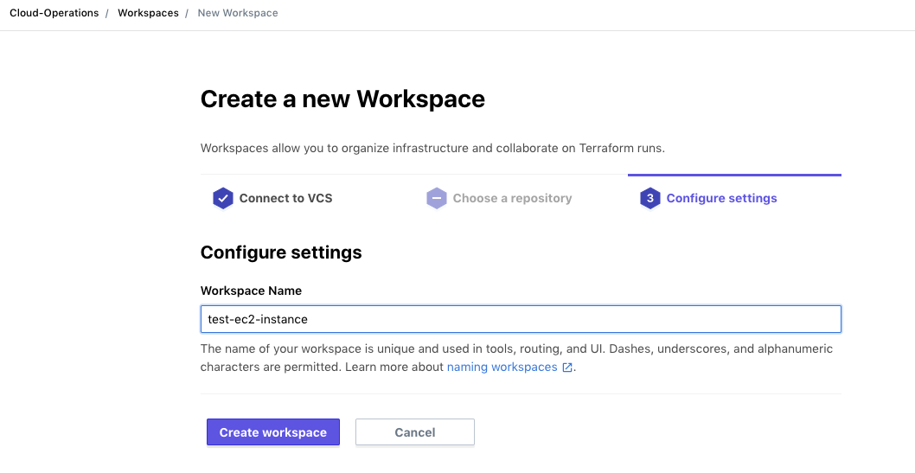
Create a Workspace in the TFC/TFE UI
Notes:
This screenshot shows creation of a workspace in the TFC UI.

Slide 88
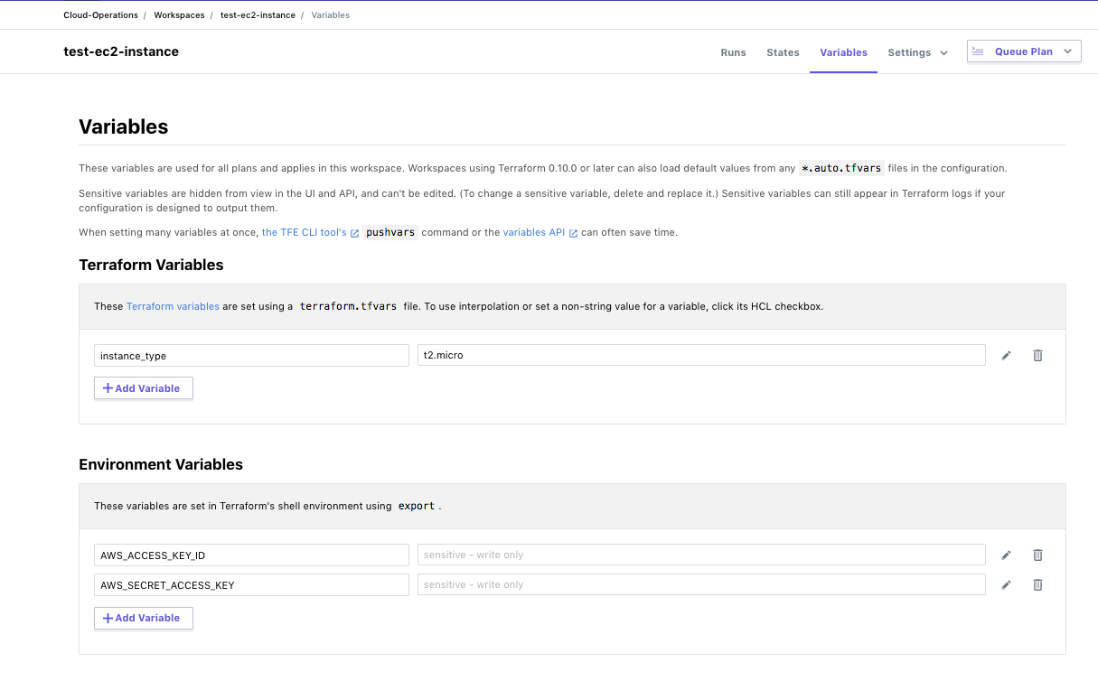
Set Variables in Your Workspace
Notes:
After creating a workspace, you will usually have to set some variables in it.
This could include both Terraform and Environment variables.
Note that environment variables cannot contain line breaks.
This is important when setting the GOOGLE_CREDENTIALS environment variable to a service account credentials file which is a JSON document; you need to strip out all the line breaks.

Slide 89
Run a Plan and Generate Mocks Against It
From your local directory containing main.tf and backend.tf, run terraform init to initialize your Terraform configuration.
Then run terraform plan.
The plan will run on the TFC server, but its results will be visible locally and in the TFC UI.
To see the run in the TFC UI, copy the URL displayed near the top of the local version of the plan and navigate to it with a browser.
To generate mocks against your plan, click the "Download Sentinel mocks" button.
After a minute, a tar.gz file will be downloaded with 7 mocks.
Extract the mock files from the tar.gz file.
Notes:
Steps 3 and 4 are running a plan against your Terraform configuration in your workspace and generating mocks from the plan.
You can run `terraform apply` instead of `terraform plan` if you want and then just find the new run in the TFC UI, but then you will need to discard the plan.
There are actually 7 mock files for Terraform 0.12 and higher: the original v1 versions of the tfplan, tfconfig, and tfstate imports, the newer v2 versions of them, and the tfrun import which only has a single version.
The tar.gz also includes a sentinel.json file which can be used with the Sentinel CLI and contains valid references to all 7 mocks.

Slide 90
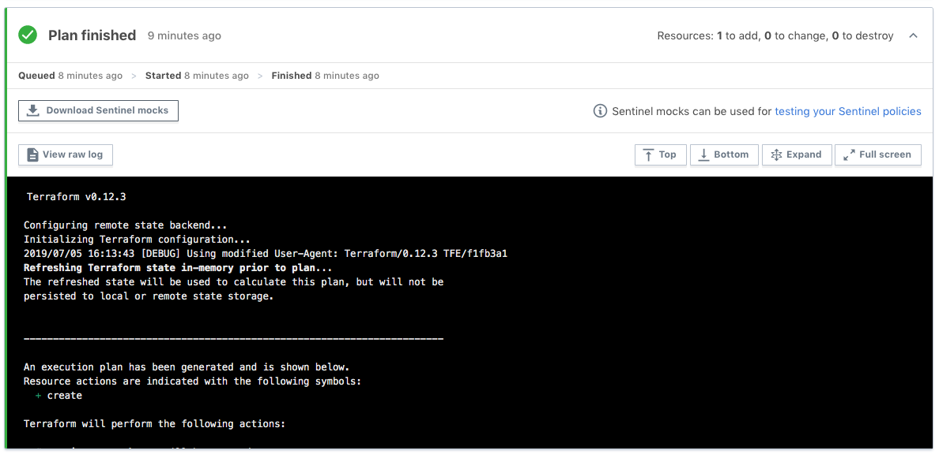
Generate Mocks Against Your Plan
Click this button
Notes:
This screenshot shows how mocks can be generated and downloaded.

Slide 91
Writing Sentinel Policies for TFC/TFE
Sometimes, you might be asked to create a Sentinel policy to restrict particular things such as VMs or load balancers.
But you might not know the exact Terraform resources that implement these.
Fortunately, you can use the Terraform Provider documentation to identify resources that implement the things you want to restrict.
Each resource and data source has its own documentation page.
Looking at documentation from the underlying cloud service provider or other technology will also help.
For instance, you can determine valid values for VM size.
Notes:
Often, when someone asks you to write a Sentinel policy for Terraform, you might not know what resources to use
You might also not know what attributes the resources have or which ones to focus on.
You'll want to review the Terraform Provider documentation for the relevant provider.
Start your search for Terraform providers at https://registry.terraform.io/browse/providers.
After selecting a provider, you can filter for resources that match what you type.

Slide 92
Write a Terraform Sentinel Policy
The next set of slides walks you through a Sentinel policy called "restrict-ec2-instance-type.sentinel" that restricts the allowed sizes of AWS EC2 instances.
It breaks down the Sentinel code into smaller bites, clarifying what each section of the code is doing.
Notes:
Step 5 is to write a Sentinel policy.
Let's walk through one over several slides.

Slide 93
Sentinel Import Declarations
# Import tfplan-functions.sentinel with alias "plan"
import "tfplan-functions" as plan
Notes:
We need to import any standard imports and any TFE Sentinel imports (tfplan/v2, tfconfig/v2, tfstate/v2, and tfrun) before we can use them.
We also need to import any Sentinel Modules that contain functions we wish to call.
In this case, we are importing the "tfplan-functions.sentinel" module with an alias set to "plan".
Note that we do not need to import tfplan/v2 since it is imported by the tfplan-functions module.

Slide 94
List of Allowed Values
# Allowed EC2 Instance Types
allowed_types = ["t2.small", "t2.medium", "t2.large"]
Notes:
We give a list of allowed EC2 instance types.
A list contains multiple items separated by commas.
If the closing bracket is on a line by itself, then the last item must have a comma after it.
If you put the closing bracket on the same line as the last item, you should leave out the final comma.

Slide 95
Call Sentinel Functions to Find and Filter Resources
# Get all EC2 instances
allEC2Instances = plan.find_resources("aws_instance")
# Filter to EC2 instances with violations
# The called function prints warnings for all violations
violatingEC2Instances = plan.filter_attribute_not_in_list(
allEC2Instances, "instance_type", allowed_types, true)
Notes:
We call the custom find_resources() function to find all EC2 instances
We then call the custom filter_attribute_not_in_list() function to filter to those EC2 instances that do not have "instance_type" set to a value in the allowed_types list.
Note that the second function prints a message for each EC2 instance that is selected by the filter. This is true of all the filter functions.
Both functions come from the tfplan-functions module that we aliased with "plan".
Recall that attributes include arguments and exported attributes.

Slide 96
Calculate Boolean and Check it in Main Rule
# Count violations
# We determine length of the messages map within the
# violatingEC2Instances object
violations = length(violatingEC2Instances["messages"])
# Main rule
main = rule {
violations is 0
}
Notes:
We set a boolean variable, violations, to the length of the violatingEC2Instances list.
The main rule will pass if violations is 0 but fail if it is not 0.
We prefer to always have a single main rule that only evaluates one or more boolean variables that have already been computed.
Doing this suppresses most of Sentinel's default TRUE/FALSE output which is really aimed at the writers of Sentinel policies, not at the consumers of them who in TFC/TFE are the writers of Terraform code that violated the policies.
Instead, we rely upon calls to Sentinel's print() function done by the filter function.

Slide 97
Common Functions
The Instruqt track in this workshop embeds two Sentinel modules with many common functions that can be used in policies.
These are copies of the functions located here.
The policy we just examined called the following functions:
find_resources(type)
filter_attribute_not_in_list(resources, attr, allowed, prtmsg)
There are other find and filter functions in the above modules.
The filter functions print all violations if prtmsg is true.
Additionally, the filter functions call a very useful function:
evaluate_attribute(r, attribute)
Notes:
Step 6 is to set up test cases for use with the Sentinel CLI and then test your policy.
The Sentinel CLI is particular about the organization and names of directories for test cases.
We need to create a test directory under the directory containing policies.
We need to create directories for each policy under the test directory.

Slide 98
Function That Finds All Resources By Type
# Find all resources of a specific type from all modules
# Only include resources that are being created or updated
find_resources = func(type) {
resources = filter tfplan.resource_changes as address, rc {
rc.type is type and
rc.mode is "managed" and
(rc.change.actions contains "create" or
rc.change.actions contains "update" or
rc.change.actions contains "read" or
rc.change.actions contains "no-op")
}
return resources
}
Notes:
The 'find_resources' function from the 'tfplan-functions' module (that we aliased with "plan") finds all resources of a given type that are not being permanently deleted.
Note that this function actually uses Sentinel's 'filter' expression.
A data source is technically a read-only resource.
In fact, the `mode` of a resource in the resource_changes collection of the tfplan/v2 import is "managed" for resources and "data" for data sources.
There is also a 'find_datasources" function in the same module.
We could have used a single find_resources() function for both resources and data sources, but then we would have had to include a `mode` parameter in the declaration of the function and every time it was called.
There are similar functions in the tfstate-functions module.

Slide 99
Function That Filters Resources
filter_attribute_not_in_list = func(resources, attr, allowed, prtmsg) {
violators = {}
messages = {}
for resources as address, rc {
v = evaluate_attribute(rc, attr) else null
if v not in allowed {
message = to_string(address) + " has " + to_string(attr) + " with value " + to_string(v) +
" that is not in the allowed list: " + to_string(allowed)
violators[address] = rc
messages[address] = message
if prtmsg {
print(message)
}
} // end if
} // end for
return {"resources":violators,"messages":messages}
}
Notes:
This is the "filter_attribute_not_in_list" function called by the policy.
We've highlighted the important parts in red.
Note that it iterates over all resources passed to it and then calls the "evaluate_attribute" function against each one to determine its value, giving `null` if it is missing. (The actual function converts null to the string "null".)
It then checks if the value is in the list of allowed values.
If not, it adds it to the violators map which is what the function returns.

Slide 100
Function that Evaluates Attributes
The filter functions all call the evaluate_attribute() function that recursively calls itself to evaluate attributes that can be deeply nested inside a resource or data source.
This function has the following declaration:
evaluate_attribute = func(r, attribute)
The resource passed to the first call to the function should be in the form rc.change.after or just rc where rc is a resource change derived by applying filters to tfplan.resource_changes.
The attribute should be given as a string delimited by "." in which indices of lists start with 0: "storage_os_disk.0.managed_disk_type".
Do not use something like "storage_os_disk[0].managed_disk_type".
Notes:
The evaluate_attribute function is very important.
It is called by all the filter functions.
There are actually versions of this in both the tfplan-functions and the tfstate-functions modules. Also in the tfconfig-functions module.
It is important to pass parameters to it in the forms it expects.
For the tfplan-functions version, pass r as `rc.change.after` in first call where rc is derived by applying filters to `tfplan.resource_changes `.
For the tfstate-functions version, pass r as `r.values` in the first call where r is derived by applying filters to `tfstate.resources`.
Pass `attribute` as a string delimited by "." in which indices of lists start with 0.
Do not use `[n]` notation for indices even though this is what you would use if working with a list directly.

Slide 101
Set Up the Test Cases Directory for the CLI
To test your policy with the Sentinel CLI, you first need to set up test cases that use the tfplan/v2 mock you generated earlier.
Under the directory containing your policy, create a test directory.
Under the test directory, create a directory with the same name as your policy, but without the ".sentinel" extension.
So, for our restrict-ec2-instance-type.sentinel policy, we create the restrict-ec2-instance-type directory under the test directory.
Notes:
Step 6 is to set up test cases for use with the Sentinel CLI and then test your policy.
The Sentinel CLI is particular about the organization and names of directories for test cases.
We need to create a test directory under the directory containing policies.
We need to create directories for each policy under the test directory.

Slide 102
Copy Mocks and Create Test Cases
Copy the mock-tfplan-v2.sentinel mock file that you downloaded and extracted from your workspace to this directory.
Change the name of the mock file to mock-tfplan-pass.sentinel.
Create a second copy of the file called mock-tfplan-fail.sentinel.
Create pass.hcl and fail.hcl files that have the text on the next two slides respectively.
Notes:
We are creating two test cases: one that will pass and one that will fail.
Each will have its own copy of the mock file that was generated from our plan.
But we will edit those mocks to have different values of the attribute we are testing.
If using tfconfig/v2, tfstate/v2, or tfrun mock files, you need to specify the mock type accordingly (instead of using "tfplan/v2").

Slide 103
The pass.hcl Test Case
module "tfplan-functions" {
source = "../../../common-functions/tfplan-functions/tfplan-functions.sentinel"
}
mock "tfplan/v2" {
module {
source = "mock-tfplan-pass.sentinel"
}
}
test {
rules = {
main = true
}
}
Notes:
The stanza at the top declares a Sentinel Module with functions that can be called by Sentinel policies that import them.
In this case, the file "tfplan-functions.sentinel" is being declared as the module "tfplan-functions". Recall that when we imported it in our policy, we gave it the alias "plan".
We also indicate that the test case should use the mock-tfplan-pass.sentinel mock and that the main rule should evaluate to true.
If using tfconfig/v2, tfstate/v2, or tfrun mock files, you need to specify the mock type accordingly (instead of using "tfplan/v2").

Slide 104
The fail.hcl Test Case
module "tfplan-functions" {
source = "../../../common-functions/tfplan-functions/tfplan-functions.sentinel"
}
mock "tfplan/v2" {
module {
source = "mock-tfplan-fail.sentinel"
}
}
test {
rules = {
main = false
}
}
Notes:
The fail.hcl test case declares the use of the same "tfplan-functions" Sentinel module.
But it uses the mock-tfplan-fail.sentinel mock and says that the main rule should evaluate to false.
This means that the fail test case will pass (and give green output) when the main rule returns false against mock-tfplan-fail.sentinel.
This can be confusing to new users of the Sentinel CLI since they expect the fail test case to fail and give red output.

Slide 105
Edit the Pass and Fail Mocks
Edit the mock-tfplan-pass.sentinel mock file and make sure that all values of instance_type are set to a value such as "t2.small" that is in the allowed_types list.
Edit the mock-tfplan-fail.sentinel mock file and make sure that at least one value of instance_type is set to a value such as "m5.large" that is not in the allowed_types list.
You should always have at least 1 fail and 1 pass test case.
Sometimes, you will want multiple fail test cases and corresponding mocks.
You might even want more than 1 pass test case and mock.
Notes:
You should always have at least one fail test case and one pass test case with corresponding mocks.
Sometimes you will want multiple fail test cases and corresponding mocks.
You might even want multiple pass test cases and corresponding mocks.

Slide 106
Test Your Policy with the CLI (1)
Now that you have set up your test cases, you can test your policy with the Sentinel CLI.
Navigate back to the directory containing your policy.
Run the following command:
sentinel test restrict-ec2-instance-type.sentinel
To see the outputs of the print statements, change this to:
sentinel test –verbose restrict-ec2-instance-type.sentinel
You can also apply a policy with the sentinel apply command, but you must set up a Sentinel configuration file like the "sentinel.json" file downloaded with the mocks or a "sentinel.hcl" file.
Notes:
We use the "sentinel test" command to test policies.
We can use the –run argument to indicate which policy we want to run, using a partial name or regex that suffices to uniquely identify the policy.
We can also specify the full policy name: "sentinel test restrict-ec2-instance-type.sentinel".
We use the –verbose argument to see output from print statements.
For using the sentinel apply command, see https://docs.hashicorp.com/sentinel/commands/apply
For Sentinel configuration files, see https://docs.hashicorp.com/sentinel/commands/config
Note that the zip file with the downloaded mocks actually contains a "sentinel.json" file which is a valid Sentinel configuration file, but you would want to edit it after moving the mocks into a different directory.

Slide 107
Test Your Policy with the CLI (2)
The first command gives:
PASS - restrict-ec2-instance-type.sentinel
PASS - test/restrict-ec2-instance-type/fail.hcl
PASS - test/restrict-ec2-instance-type/pass.hcl
The second command gives:
PASS - restrict-ec2-instance-type.sentinel
PASS - test/restrict-ec2-instance-type/fail.hcl
logs:
aws_instance.ubuntu[0] has instance_type t2.xlarge that is not in the allowed list:
["t2.small" "t2.medium" "t2.large"]
restrict-ec2-instance-type.sentinel:24:1 - Rule "main
Description: Main rule Value: false
PASS - test/restrict-ec2-instance-type/pass.json
restrict-ec2-instance-type.sentinel:24:1 - Rule "main
Description: Main rule Value: true
Notes:
We have condensed the output for the verbose option a bit.
We emphasize again that the fail.hcl test case passes and has green output even though the main rule for it returned false.
This is by design. All test cases should be configured to pass.
Step 7 is to revise your policy and test cases until the latter all pass
Step 8 is to deploy your policy to TFE organizations

Slide 108
Using Sentinel in Terraform Cloud and Terraform Enterprise
Notes:
While we won't be using Sentinel in Terraform Cloud or Terraform Enterprise today, we did want to review this topic
After all, that is where your Sentinel policies will really be running.
You'll get a chance to complete and test some more Sentinel policies with the Sentinel CLI after this section.

Slide 109
Testing Policies in Terraform Cloud
After successfully testing a policy with the CLI, you might also want to test it against actual Terraform code on a TFC or TFE server.
When doing this, we suggest you follow these recommendations:
Put each new policy in a policy set that does not contain any other policies.
Assign the workspaces you will be using to test your policy to that policy set.
Do not assign any other workspaces to the policy set.
Set the policy enforcement level to hard mandatory.
Following these recommendations will make your testing easier:
You won't see results from other policies.
You won't have to worry about overriding soft-mandatory failures.
Notes:
After testing new Sentinel policies with the Sentinel CLI, you can test them in an organization on a TFC or TFE server.

Slide 110
Creating Policy Sets with Policies
Policy Sets are created in a VCS repository.
Each policy set contains the policies and a configuration file called "sentinel.hcl" that lists the policies and their enforcement levels.
The "sentinel.hcl" file can also specify Sentinel modules to load.
Policies and Modules can be in any directory of the current repository and even in remote repositories.
You then configure the policy set in the Terraform Cloud UI by registering it, indicating the repository, branch, and policies path.
You can specify Parameters for it including sensitive ones.
You determine the workspaces it should be enforced on.
Notes:
You'll need to create policy sets that contain the policies you want to use in TFC or TFE
You can now specify Sentinel modules in your policy sets.
References to policies and modules in the same repository can use `..` to point to files outside the directory containing sentinel.hcl
Policies and Sentinel modules can be loaded from remote repositories using URLs that point to the raw files.

Slide 111
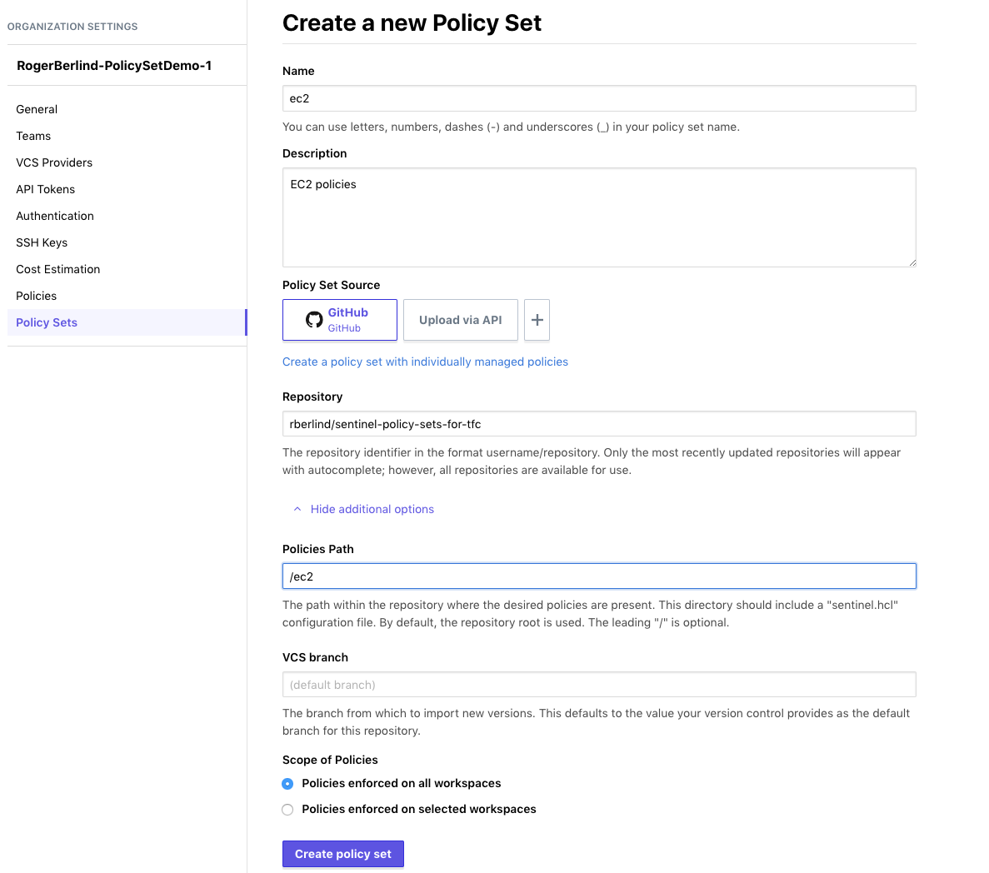
Notes:
This screenshot shows a VCS-backed policy set being registered in a TFC organization.

Slide 112
Example Policy Set
Here is an example policy set:
module "tfplan-functions" {
source = "../common-functions/tfplan-functions/tfplan
-functions.sentinel"
}
policy "restrict-ec2-instance-type" {
source = "./restrict-ec2-instance-type.sentinel"
enforcement_level = "soft-mandatory"
}
Notes:
You'll need to create policy sets that contain the policies you want to use in TFC or TFE
You can now specify Sentinel modules in your policy sets, but the modules must be in or under the directory with the sentinel.hcl file at this time.
In the near future, we will support loading of modules from remote locations.

Slide 113
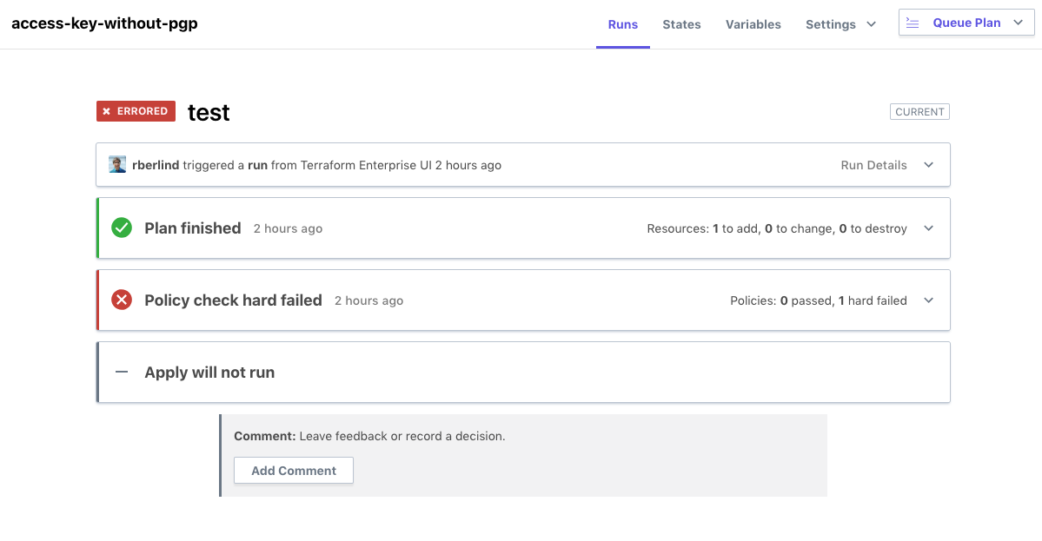
Sentinel Policy that Fails
Notes:
This screenshot shows a Sentinel policy check failing during a run in a TFC workspace.

Slide 114
Sentinel Policy that Fails
## Policy 1: terraform-guides-aws/restrict-ec2-instance-type (hard-mandatory)
Result: false
Description: This policy uses the Sentinel tfplan/v2 import to require that
all EC2 instances have instance types from an allowed list
Print messages:
aws_instance.this has instance_type t2.micro that is not in the allowed list ["t2.small" "t2.medium" "t2.large"]
restrict-ec2-instance-type.sentinel:24:1 - Rule "main
Description: Main rule
Value: false
Notes:
This screenshot shows more details of a Sentinel policy failing during a run in a TFC workspace.
Note that json output from Sentinel policies can be viewed and filtered.

Slide 115
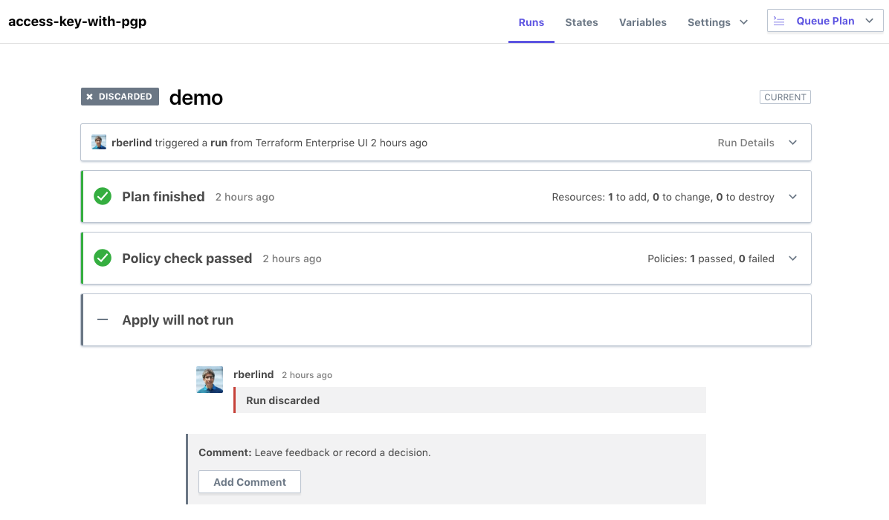
Sentinel Policy that Passes
Notes:
This screenshot shows a Sentinel policy check passing during a run in a TFC workspace.

Slide 116
Sentinel Policy that Passes
## Policy 1: terraform-guides-aws/restrict-ec2-instance-type (hard-mandatory)
Result: true
Description: This policy uses the Sentinel tfplan/v2 import to require that
all EC2 instances have instance types from an allowed list
restrict-ec2-instance-type.sentinel:24:1 - Rule "main
Description: Main rule
Value: false
Notes:
This screenshot shows more details of a Sentinel policy passing during a run in a TFC workspace.

Slide 117
Deploying Policies in Terraform Cloud
After successfully testing a policy with the CLI and possibly also on TFC itself, you will want to deploy it to your TFC organizations.
If you have not already added the policy to a policy set in your organizations, do that at this time.
Add the new policy to an existing policy set that is already applied against desired workspaces, or create a new policy set for the policy and apply that policy set to desired workspaces across your organizations.
Also add any parameters the policy requires to your policy set.
And add references to any Sentinel Modules that policies in it use.
Notes:
After testing a policy with the Sentinel CLI and possibly in a TFC/TFE organization, you'll want to deploy it to your TFC organizations.

Slide 118
Advanced Techniques
Notes:
In this section, we discuss some advanced techniques for writing Sentinel policies for Terraform.

Slide 119
Debugging Policies with Errors
If your policy shows any syntax errors, these will tell you which lines of your policy you need to fix.
A message like "An error occurred: <policy>.sentinel:34:10" means Sentinel encountered an error in column 10 of line 34 of the policy.
But the problem that caused the error could occur earlier in the code.
Some errors are caused by simple things like missing commas or braces. These are fairly easy to spot.
Other errors might be caused by missing or computed attributes or by null values. Consider adding checks that test for these possibilities.
Add extra print statements to help you narrow down where the error is occurring.
You can even print an entire resource: print("resource:", r)
Notes:
But remember that the print() function is not just for debugging!
Be sure to print clear violation messages that report the full address of violating resources or data sources for all violations.
The third-generation common functions that start with 'filter" do this for you.
Default Sentinel output prior to Sentinel 0.17 also included TRUE/FALSE lines with line numbers, indicating whether rules and boolean expressions they evaluate were TRUE or FALSE. But this information was not really useful to people who violate the policies. In Sentinel 0.17, rules can return non-boolean data such as lists and maps and the default Sentinel output was changed to show the customer-provided outputs of their rules including the main rule.
Note, however, that some data is truncated when rules return complex data and the –json flag is not used.

Slide 120
Checking for Missing Expressions
An expression can fail to exist in multiple ways:
It could be absent from the data which gives undefined.
It could be set to null or the empty string ("").
It could be an empty map, {}, or an empty list, [].
Verify an expression is not undefined, null, or "":
x else null not in [null, ""]
Verify an expression is not undefined, null or an empty map, list, or string:
not ( (x else null is null) or (types.type_of(x) in ["map", "list", "string"] and length(x) is 0) )
The length() function can only be applied to strings, maps, and lists, so the type of an expression should be checked before using it.
Notes:
Using `x else null not in [null, ""]` checks that an attribute is not undefined, null, or an empty string (""). If x is missing, it will be undefined, but the else operator will convert it to null. So, we don't include undefined in the list.
You could use `x else "" not in [null, ""]` to achieve the same result.
Using `x else null is not null` lets you check that an attribute is neither undefined nor null but it does not prevent "".
Using `x else "" is not ""` lets you check that an attribute is neither undefined nor the empty string, "", but it does not prevent null.
Which expression you use depends on what values the attribute you are testing could have; some will have null (especially with Terraform 0.12 and higher) while others might have "". So, using these simplified conditions is ok when you know what to expect.
The order of conditions in compound expressions is important to avoid errors. In the last compound condition, if x is undefined, the first condition inside not (...) converts it to null, making the first condition true. And if the first expression is true (because x is null or undefined), Sentinel's short-circuit logic prevents the rest of the conditions inside not(...) from being evaluated, so we don't have to worry about undefined or null in them. (Note that length(null) gives undefined and would cause an error without short-circuit logic.)
The expression `types.type_of(null)` gives "null", so passing null to it would be ok, but `types.type_of(undefined)` gives undefined and would also cause an error without short-circuit logic.

Slide 121
Restricting Multiple Attributes in a Policy
If you want to restrict multiple attributes in a single policy, you can call multiple filter functions and then check the lengths of all the lists they returned.
Alternatively, you can write your own custom function that tests all of the attributes while iterating over the instances just once.
In this case, you should return a map with a boolean for each attribute that you are restricting.
We recommend calling any filter or validation functions before your main rule and evaluating the lengths of the lists or the booleans they return in the main rule to minimize verbose Sentinel output.
Notes:
Sometimes, you will want to restrict multiple attributes of a resource or data source in a policy.

Slide 122
Making Calls to External API Endpoints
Sentinel policies in Terraform Cloud and Terraform Enterprise can use the http import to call external API endpoints.
Parameters can be added to policy sets allowing the secure introduction of credentials needed by API endpoints invoked with the Sentinel HTTP import.
Currently, the http import supports the HTTP GET and POST operations against API endpoints that return JSON documents.
The http import can send data to an API endpoint with the http import using headers or URL parameters.
But sending data in the URL parameters is insecure, and there are limits on the size of headers.
Some example policies that use the http import are here.
Notes:
Sentinel's HTTP import can be used in policies to call external API endpoints.

Slide 123
About the Workshop Exercises
Notes:
You will now do the next Instruqt challenge which is Exercise 1.

Slide 124
The Original Guide's Exercises
The Writing and Testing Sentinel Policies for Terraform guide that this presentation is based on contained 5 exercises designed to make readers capable of independently writing and testing new Sentinel policies.
Those exercises intentionally did not provide step-by-step, copy-and-paste instructions since we feel it is better for people to try to write their own policies by following the guide's 8-step methodology.
That methodology includes reading Terraform provider documentation to determine the resources and attributes that a policy should focus on.
This approach can be effective for someone working by themself.
But it is more difficult in a workshop or class setting in which time is limited.
Notes:
The next 5 challenges of the Instruqt track will guide you through the completion of some exercises from the Writing and Testing Sentinel Policies for Terraform guide.

Slide 125
The Workshop Exercises
Fortunately, we found a happy medium between the step-by-step, copy-and-paste and the write everything yourself approaches.
We've made things easier in the Instruqt challenges that implement the exercises by writing most of each policy and by providing the test cases and mocks needed to test it.
You need to finish each policy, save it, and then run the sentinel test command to verify that it behaves correctly.
You'll be asked to complete 2 different versions of the policies in exercises 2-5 across two challenges each.
Please use the link for the Sentinel for Terraform (v4) Instruqt track provided by your instructor.
Notes:
The workshop exercises leverage the Instruqt platform and make solving the exercises much easier.
Sentinel for Terraform (v4) track

Slide 126
Challenge Flow
After launching each challenge, you should read the note screens while the challenge loads to learn about the challenge's task:
When the "Start" button appears, click it to view the challenge's assignment and begin following the instructions.
Each challenge has 3 tabs:
The Policies tab lets you edit policies.
The Test Cases tab lets you inspect test cases and the mocks.
The Sentinel CLI tab lets you run the sentinel test command.
Notes:
We discuss the basic challenge flow here

Slide 127
Completing the Sentinel Policies (1)
By reviewing the note screens before each challenge, the links in them, the challenge assignment, and/or these slides, you should be able to successfully complete each policy.
We also want to emphasize that you do not need any cloud accounts or HashiCorp software to write and test the policies since you will be using the Sentinel CLI in a VM loaded by the track to test the policies after you complete them.
You will need to replace placeholders like <resource_type>, <attribute>, and <condition> in each policy with suitable Sentinel expressions or values in order to complete the policies. But keep any quotes around placeholders.
Remember that "attributes" includes "arguments" of resources.
Notes:
Please do open the links given in the notes in browser tabs outside of Instruqt.
The information in them will help you complete the policies.

Slide 128
Completing the Sentinel Policies (2)
Please do NOT edit the mock files; that would be cheating.
Be sure to look at the suggested Terraform provider link for each challenge; this will help you identify a resource or data source and one of its attributes to use.
Also look at suggested links about specific Sentinel features.
Replace as many of the placeholders as you can. If you can't replace one of them, save the policy by clicking on the disk icon above the policy and click the Check button to get a hint.
This might give you a useful hint. If not, try removing the placeholder, saving the policy, and clicking the Check button again to receive a bigger hint.
Notes:
Looking at the mock files of each challenge can also help you determine the resource or data source and its relevant attribute to use, but we discourage you from doing that unless absolutely necessary since when you write your own policies, you will have to review the Terraform provider docs first in order to write some Terraform code from which you will generate mock files after running a plan against it. Looking at the mock files is a mild form of cheating.

Slide 129
Completing the Sentinel Policies (3)
After replacing all the placeholders, please do the following:
Save the file.
Run the sentinel test command with the specified arguments.
All test cases should pass. If not, edit the policy and repeat the above 2 steps.
Keep doing this until all the test cases pass.
Don't forget that clicking the Check button will give hints.
Notes:
All test cases should pass when you run the "sentinel test" command.
If not, keep repeating the given process until they do pass.
Don't forget that clicking the Check button will give hints.

Slide 130
Workshop Challenge: Exercise 1
Notes:
You will now do the next Instruqt challenge which is Exercise 1.

Slide 131
Exercise 1: Restrict Vault Auth Methods
Your task in this challenge is to complete and test a Sentinel policy that restricts the Vault authentication methods (backends) provisioned by Terraform's Vault Provider.
The policy uses the tfplan/v2 import and is very similar to the sample restrict-ec2-instance-type.sentinel policy we just reviewed.

Slide 132
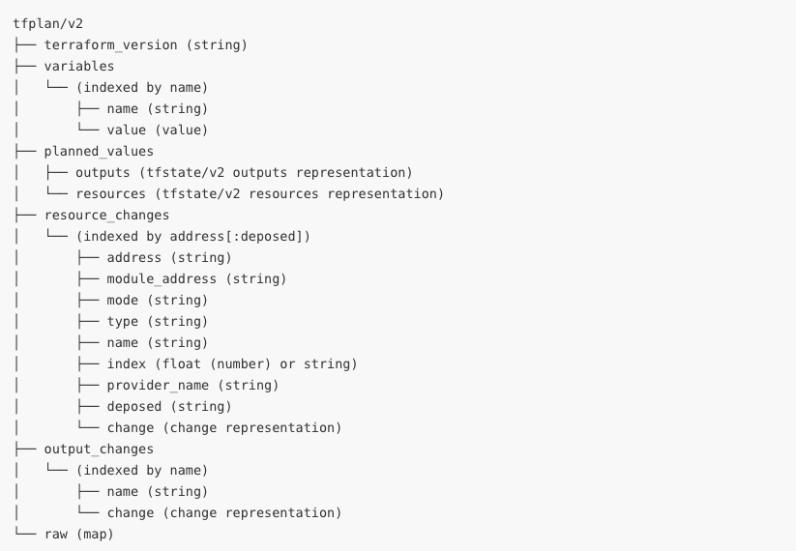
The tfplan/v2 Import
Notes:
This screenshot shows the collections of the tfplan/v2 import.
This is from https://www.terraform.io/docs/cloud/sentinel/import/tfplan-v2.html#import-overview.
What we want to focus on here is the organization of data exposed to the tfplan/v2 import for resources under the resource_changes collection.
While the v1 tfplan import organized resources in 3 layers (by type, name, and index), the v2 import has a flat map that is indexed by the full address of resources. This is one of the things that makes the v2 import easier to work with.
For more details, see https://www.terraform.io/docs/cloud/sentinel/import/tfplan-v2.html#the-resource_changes-collection

Slide 133
Using the tfplan/v2 Import
The tfplan/v2 import includes two different collections, planned_values and resource_changes, that can be used to evaluate the expected values of resource and data source attributes (including both arguments and exported attributes) if an apply were run.
Using the resource_changes collection is generally preferred because it includes more information about changes being made to new or existing resources.
This data includes the actions being performed such as "create", "update", and "delete", the values of attributes before and after the change, and the after_unknown collection of booleans indicating if the values are computed (will not be known until after the apply).
Notes:
The `resource_changes` collection is generally more useful than the `planned_values` collection.
It provides more information.
Note that the `after_unknown` collection has flags for computed values (those known after an apply)
The `planned-values` collection gives the predicted state after the apply and uses the same data structures as the tfstate/v2 resources and outputs collections. It is structured like the `applied` key of the tfplan/v1 import.
However, it combines current state with changes being made by the plan.

Slide 134
Example of tfplan/v2 Resource Data (1)
Recall the Terraform code we showed earlier that creates two instances of an "aws_instance" resource with name "ubuntu":
resource "aws_instance" "ubuntu" {
count = 2
ami = "${var.ami_id}"
instance_type = "${var.instance_type}"
}
Notes:
Recall the Terraform code that creates two instances of a resource of type "aws_instance" named "ubuntu".

Slide 135
Example of tfplan/v2 Resource Data (2)
A changed resource instance will appear in the tfplan/v2 import like this:
resource_changes = {
"aws_instance.ubuntu[0]": {
"address": "aws_instance.ubuntu[0]",
"change": {
"after": {
"instance_type": "t2.small", },
},
"mode": "managed",
"name": "ubuntu",
"type": "aws_instance",
},
"aws_instance.ubuntu[1]": {}
Notes:
The data for resources is organized in a flat map indexed by the full resource address.
Instance numbering starts at 0.
We've colored a few items red to show the path in the resource_changes collection to an attribute like `instance_type`.
So, we could refer to that as `tfplan.resource_changes["aws_instance.ubuntu[0]"].change.after.instance_type`.
But we never actually would since we would use the filter quantifier or a for loop to iterate over resource changes and use an iteration variable like `rc` to represent `tfplan.resource_changes[aws_instance.ubuntu[0]]`; so, we would actually refer to `rc.change.after.instance_type`.
We have left off a lot of the data including the `actions` of the `change`, most of the data under `after`, the `after_unknown` and `before` collections of the `change`, the `index`, the `module_address`, and the `provider_name`.

Slide 136
Workshop Challenge: Exercise 2 (parts a and b)
Notes:
You will now do the next two Instruqt challenges which are Exercise 2, parts a and b.

Slide 137
Exercise 2: Restrict AWS IAM access keys
Your task in these challenges is to complete and test 2 versions of a Sentinel policy that requires that all AWS IAM access keys provisioned by Terraform's AWS Provider include a PGP key that starts with "keybase:".
The policy uses the tfplan/v2 import.
The first version calls common functions to find and filter resources.
The second version does the filtering inside the policy itself, requiring you to use for loops, if/else conditionals, and the strings import.

Slide 138
Workshop Challenge: Exercise 3 (parts a and b)
Notes:
You will now do the next 2 Instruqt challenges which are Exercise 3, parts a and b.

Slide 139
Exercise 3: Restrict AWS ACM Certificates
Your task in these challenges is to complete and test two versions of a Sentinel policy that requires that all AWS Certificate Manager (ACM) Certificates referenced by a data source in Terraform's AWS Provider have domains that are subdomains of "hashidemos.io".
Since we are restricting a data source, the policy uses the tfstate/v2 import instead of the tfplan/v2 import that we have used in previous policies.
It also uses the matches operator.
The first version of the policy uses filters both to find an initial list of resources and to find those that violate the policy.
The second version of the policy has you write your own validation function.

Slide 140
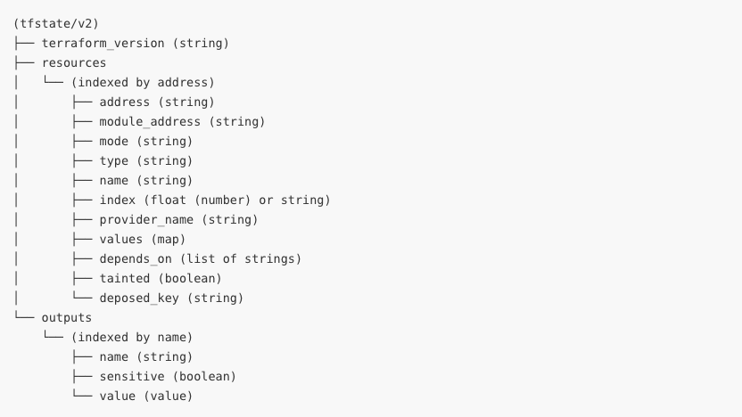
The tfstate/v2 Import
Notes:
This screenshot shows the collections of the tfstate/v2 import.
This is from https://www.terraform.io/docs/cloud/sentinel/import/tfstate-v2.html#import-overview.
While the v1 tfstate import organized resources in 3 layers (by type, name, and index), the v2 import has a flat map that is indexed by the full address of resources. This is one of the things that makes the v2 import easier to work with.
For more details, see https://www.terraform.io/docs/cloud/sentinel/import/tfstate-v2.html#the-resources-collection
The planned_values collection of the tfplan/v2 import has similar data, but includes predictions of what the state will look like after the apply since it combines current state with the current plan.
The tfstate/v2 import only shows data actually in the state after the plan.
Note that this can include new state for data sources that were evaluated during the refresh operation done by the plan.
This occurs if the data source does not reference any computed values. Otherwise, evaluation of the data source is delayed until the apply.

Slide 141
Using the tfstate/v2 Import
The tfstate/v2 import gives the state of resources and data sources after a plan.
Generally, this will be the same as the state before the plan, but it could include additional data for data sources that were evaluated during the refresh operation done by the plan.
Data sources that do not reference computed values are evaluated during the plan.
Data sources that reference computed values are not evaluated until the apply.
As a consequence, the tfstate/v2 import is often more useful than the tfplan/v2 import when restricting data sources in policies.

Slide 142
Workshop Challenge: Exercise 4 (parts a and b)
Notes:
You will now do the next 2 Instruqt challenges which are Exercise 4, parts a and b.

Slide 143
Exercise 4: Restrict Google Compute Instances
Your task in these challenges is to complete and test two versions of a Sentinel policy that requires Google compute instances provisioned by Terraform's Google Provider to use the public image "debian-cloud/debian-9".
This policy uses the tfplan/v2 import.
However, it requires you to evaluate an attribute that is inside a block that is itself inside another block of the resource.
The first version will call common functions to do this.
The second version requires you to write your own filter function and deal with the nested attribute more directly.
You'll also be using the types import.

Slide 144
Restricting Nested Attributes in a Policy (1)
Some attributes of Terraform resource are "top-level" attributes that reside directly under the resource.
Other "nested" attributes are inside blocks of the resource.
Since blocks can be nested inside other blocks, an attribute can be nested many layers beneath the resource itself.
When writing policies that restrict nested attributes, you can do this using Sentinel's native syntax or call special functions that use a slightly modified syntax.
Recall that "attributes" includes both the "arguments" and "exported attributes" of resources.
In fact, all the arguments are actually exported.
Notes:
Technically, resources have "arguments" and "exported attributes", but it is common to talk about the "attributes" of resources in a way that covers both the arguments and the exported attributes.
The reason the union of arguments and exported attributes is called "attributes" is that all arguments of resources and data sources are exported.
Some attributes are "top-level" attributes while others are "nested" inside blocks that could be nested inside other blocks, etc.

Slide 145
Restricting Nested Attributes in a Policy (2)
Sentinel treats blocks as lists of maps. This is true even when a block cannot be repeated.
The first index of a Sentinel list is always 0.
The value of a nested attribute of a resource change, rc, derived from the resource_changes collection of the tfplan/v2 import can be directly referenced like this:
rc.change.after.storage_image_reference[0].publisher
A nested attribute of a resource r derived from the resources collection of the tfstate/v2 import can be referenced like this:
r.values.storage_image_reference[0].publisher
Notes:
The example given is for an azurerm_virtual_machine resource.

Slide 146
Restricting Nested Attributes in a Policy (3)
The evaluate_attribute(r, attribute) functions in this workshop's Sentinel modules can evaluate all attributes of resources and data sources no matter how deeply they are nested.
However, the evaluate_attribute functions expect nested attributes to be specified with a string delimited by "." in which each item of the string represents one of the following:
the name of a block above the attribute
an index of a block (0, 1, 2, etc.)
the name of the attribute itself.
So, we would set the function's attribute parameter to something like:
"storage_image_reference.0.publisher"
We don't include rc.change.after or r.values since that is set in r.
Notes:
Technically, resources have "arguments" and "exported attributes", but it is common to talk about the "attributes" of resources in a way that covers both the arguments and the exported attributes.
Some attributes are "top-level" attributes while others are "nested" inside

Slide 147
Workshop Challenge: Exercise 5 (parts a and b)
Notes:
You will now do the next 2 Instruqt challenges which are Exercise 5, parts a and b.

Slide 148
Exercise 5: Require Modules from a PMR
Your task in these challenges is to complete and test two versions of a Sentinel policy that requires that all modules loaded by the root module come from the Private Module Registry (PMR) of a Terraform Cloud organization.
This policy uses the tfconfig/v2 import.
In the first version, you will write a custom validation function.
In the second version, you will move this function into a Sentinel module.

Slide 149
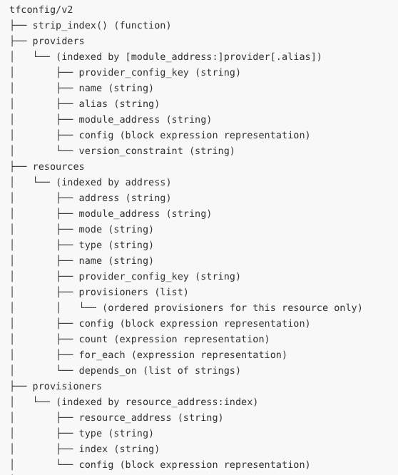
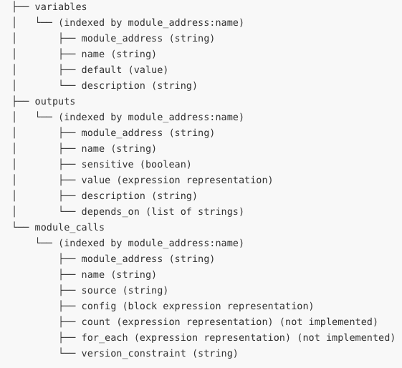
The tfconfig/v2 Import
Notes:
These screenshots show the collections of the tfconfig/v2 import.
This is from https://www.terraform.io/docs/cloud/sentinel/import/tfconfig-v2.html#import-overview.
While the v1 tfconfig import organized resources in 2 layers (by type and name, but no index), the v2 import has a flat map that is indexed by the full address of resources as they exist in the Terraform code. Index for resources that use count or for_each is not included in this address.
For more details, see https://www.terraform.io/docs/cloud/sentinel/import/tfconfig-v2.html#the-resources-collection

Slide 150
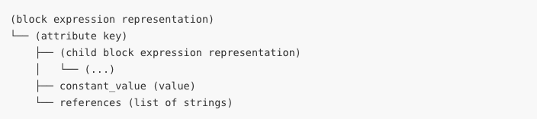
The tfconfig/v2 Import Expressions
Expressions in the tfconfig/v2 collections are ultimately represented by constant_value fields or by references lists, depending on whether they were constant or required evaluation.
The latter must then be cross-referenced against the tfplan/v2 or tfstate/v2 imports.
When constants are mixed with references, the constants are lost.
Notes:
Data in the tfconfig/v2 import is ultimately divided between `constant_value` fields and `references` lists.
The latter must be cross-referenced against the tfplan/v2 or tfstate/v2 imports.
This makes the tfconfig/v2 import hard to work with if the expressions being evaluated are not constants.

Slide 151
Using the tfconfig/v2 Import
The tfconfig/v2 import gives information about the Terraform configuration used by the run in which Sentinel policies are checked.
It does NOT give all information about the Terraform configuration.
It can be used to restrict the configuration of module calls, variables, resources, data sources, providers, provisioners, and outputs.
It can also be used to compare attributes of different resources even if they are computed since it can compare the expressions the code used.
It is useful for restricting things that the other imports don't cover.
However, using it to restrict resources and data sources can be challenging because of the need to cross-reference references.
Notes:
The tfconfig/v2 import gives information about the Terraform configuration (code) used by the run.
But it does not give all information about the configuration. For instance, it does not include local values.
It can be used to restrict various things that are not covered by the other imports.
Cross-referencing of references should only be done by advanced users and only when a policy cannot be implemented with the tfplan/v2 and tfstate/v2 imports.

Slide 152
Workshop Challenge: Extra Credit
Notes:
You will now do the next and last Instruqt challenge which is an Extra Credit challenge.

Slide 153
Extra Credit: Restrict Production Workspaces
Your task in this challenge is to complete and test a Sentinel policy that prevents any workspace with a name starting with "prod-" or ending in "-prod" from having the Auto Apply property set to "true".
This policy uses the tfrun import.

Slide 154
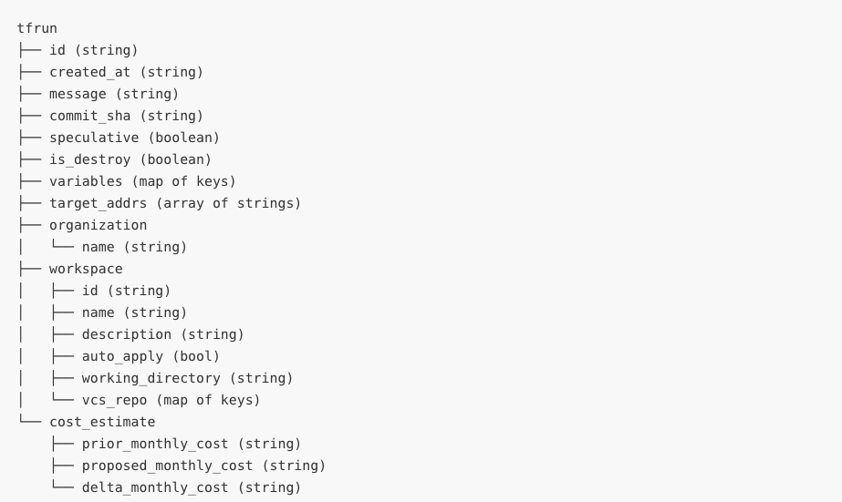
The tfrun Import
Notes:
This screenshot shows the attributes and collections of the tfrun import.
This is from https://www.terraform.io/docs/cloud/sentinel/import/tfrun.html.

Slide 155
Using the tfrun Import
The tfrun import gives some useful information about a run and the workspace it was run in.
This includes the following:
The ID of the run and when it was created.
The workspace's name, description, and other settings
Whether the plan was speculative or a destroy plan
A list of variables set for the run, indicating their names, their category (Terraform or Environment), and whether they were marked as sensitive.
Target addresses specified in the run with the –target flag.
Cost estimates calculated during the run's cost estimation phase.
Notes:
The tfrun import gives some useful information about a run and the workspace it was run in

Slide 156
Use Cases for the tfrun Import
There are two main use cases for the tfrun import:
Restricting the costs of cloud resources by evaluating cost estimates generated for AWS, Azure, and GCP between the plan and the running of Sentinel policy checks.
Selectively applying policy conditions to different workspaces based on their names:
For instance, don't allow Auto Apply to be set in workspaces with names starting in "prod-" or ending in "-prod".
But only do this if the governance team is controlling workspace names.
Checking that certain conditions are satisfied before allowing a destroy to be done against the entire workspace.
Notes:
Some policies will need to use the tfrun import, especially if inspecting TFC's cost estimates.

Slide 157
Solutions to Exercises
Notes:
In this section, we discuss some advanced techniques for writing Sentinel policies for Terraform.

Slide 158
Solutions to Challenges
You will find solutions to Exercises all 10 challenges of the Sentinel for Terraform (v4) track here:
https://github.com/hashicorp/sentinel-training-solution
Please refrain from looking at them until you've tried to solve the challenges on your own.
You won't learn as much by copying and pasting from the solutions as you will by reading relevant links and trying to complete the policies on your own.

Slide 159
Notes:
Thanks for attending the Sentinel in Terraform Workshop or reviewing these slides.

